Slide 1
The Square Variation of Rearranged Fourier Series
Allison Lewko Mark Lewko
Columbia University
Institute for
Advanced Study
TexPoint fonts used in EMF.
Read the TexPoint manual before you delete this box.: AAAAAAAA

Slide 2

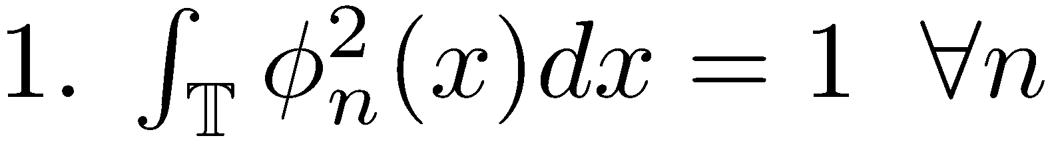
Background on Orthonormal Systems

Slide 3
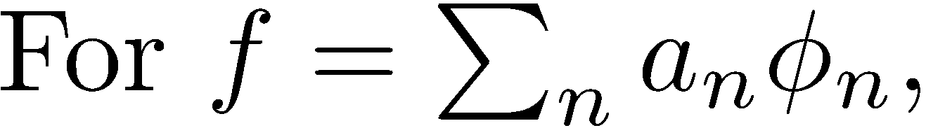
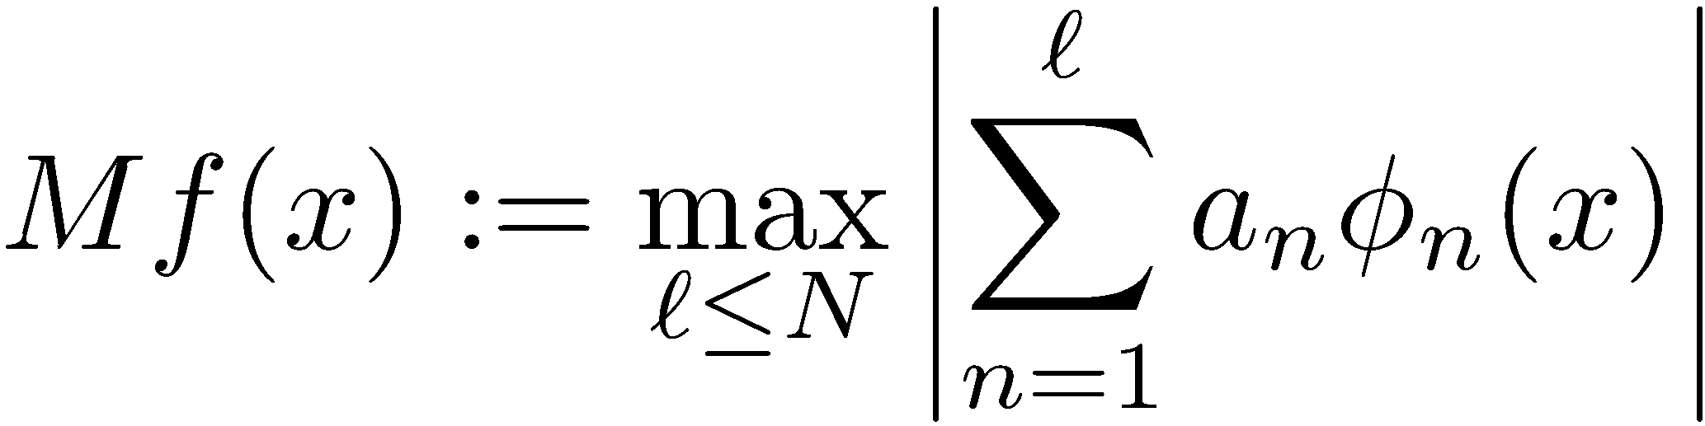
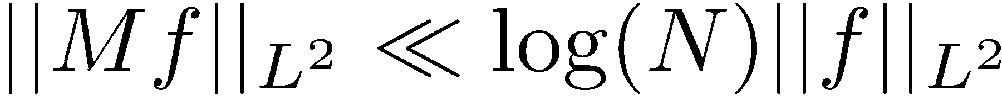
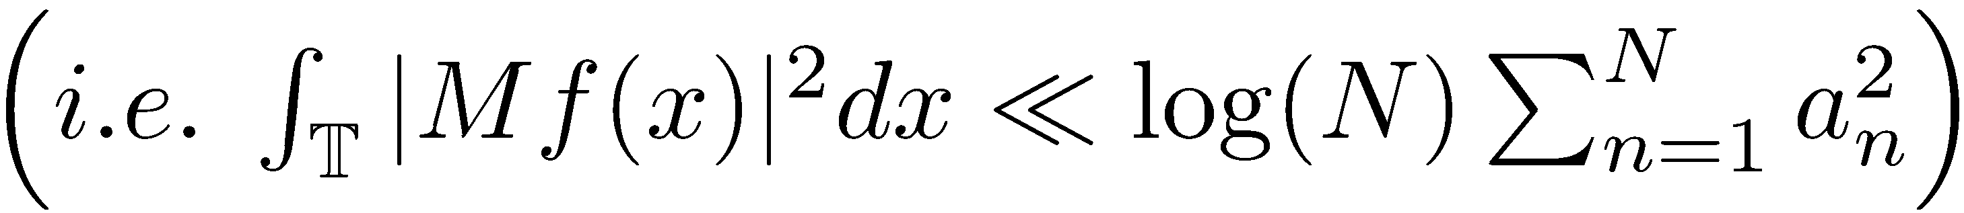
Background on Orthonormal Systems

Slide 4

Sensitivity to Ordering
Would imply
“Yes” above

Slide 5
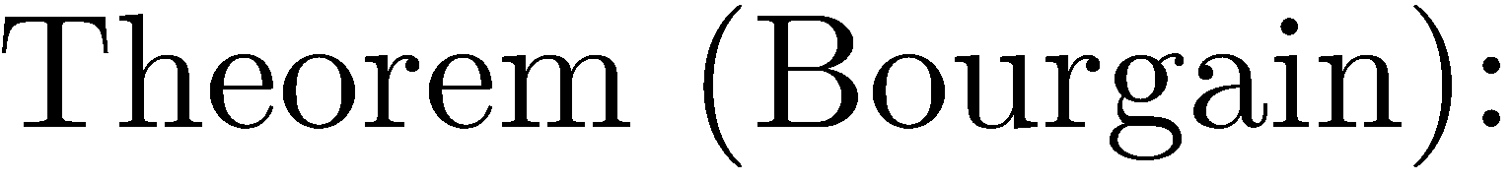
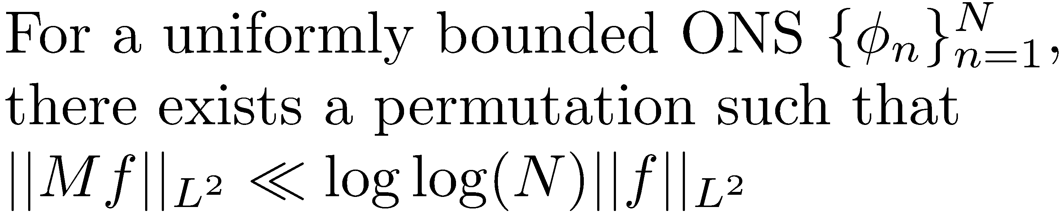
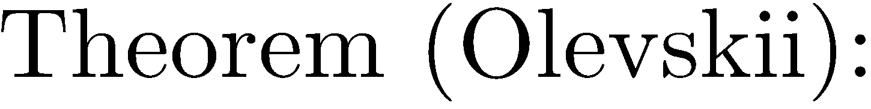
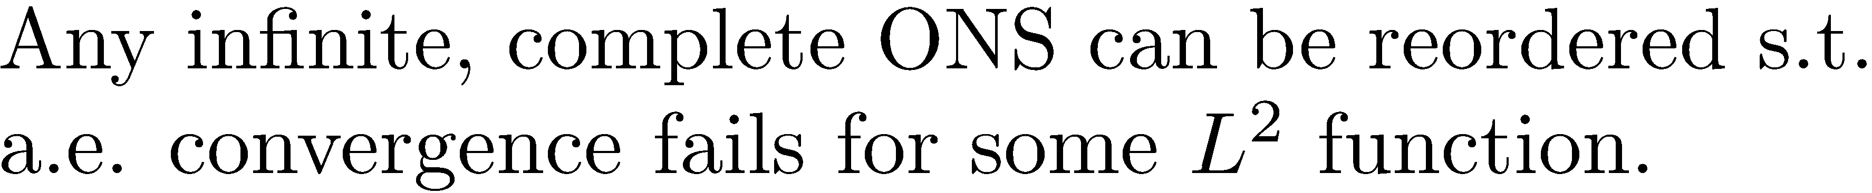
Known Results For Reorderings

Slide 6
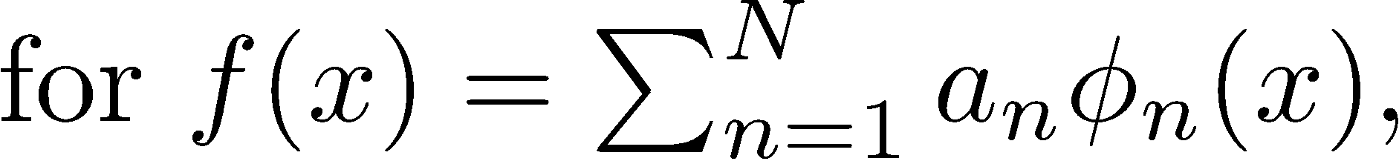
Variation Operators

Slide 7
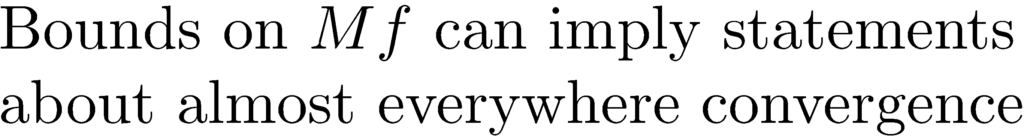
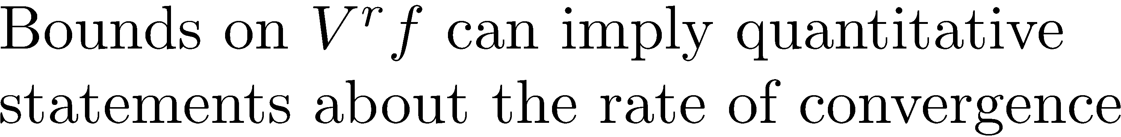
Comparing Maximal and Variation Operators

Slide 8
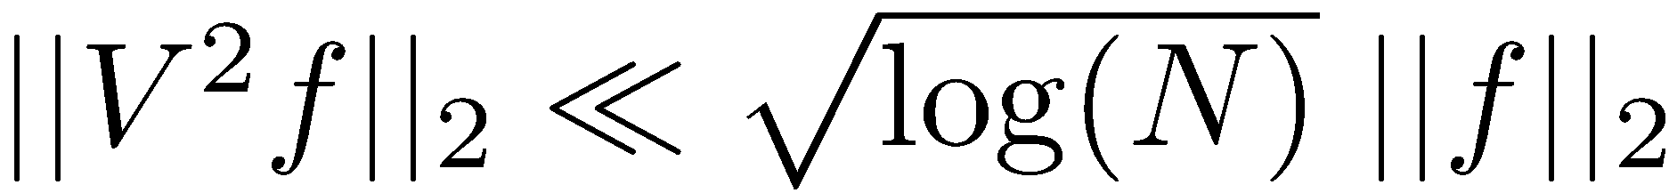
Variation Results for the Trigonometric System

Slide 9

What Tools Do We Have to Analyze Variation?

Slide 10
Dyadic Intervals
Arbitrary subinterval can be decomposed into dyadic pieces
Arbitrary subinterval is contained in dyadic interval of comparable length (approx.)

Slide 11
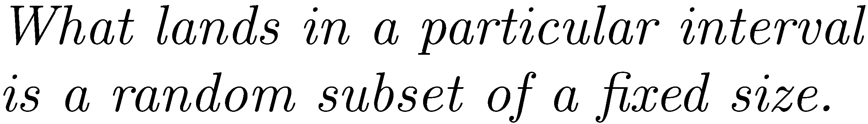
How Do We Reorder?

Slide 12

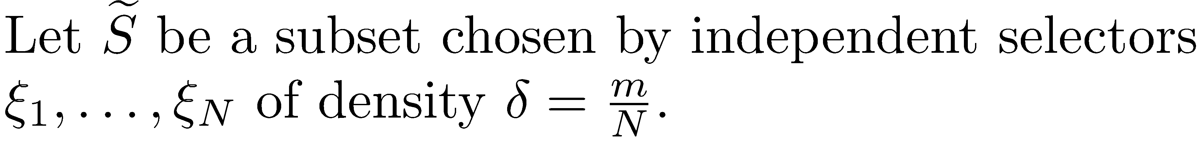
From Selectors to Fixed Size Subsets

Slide 13
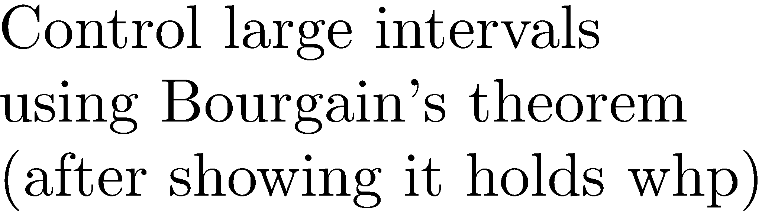


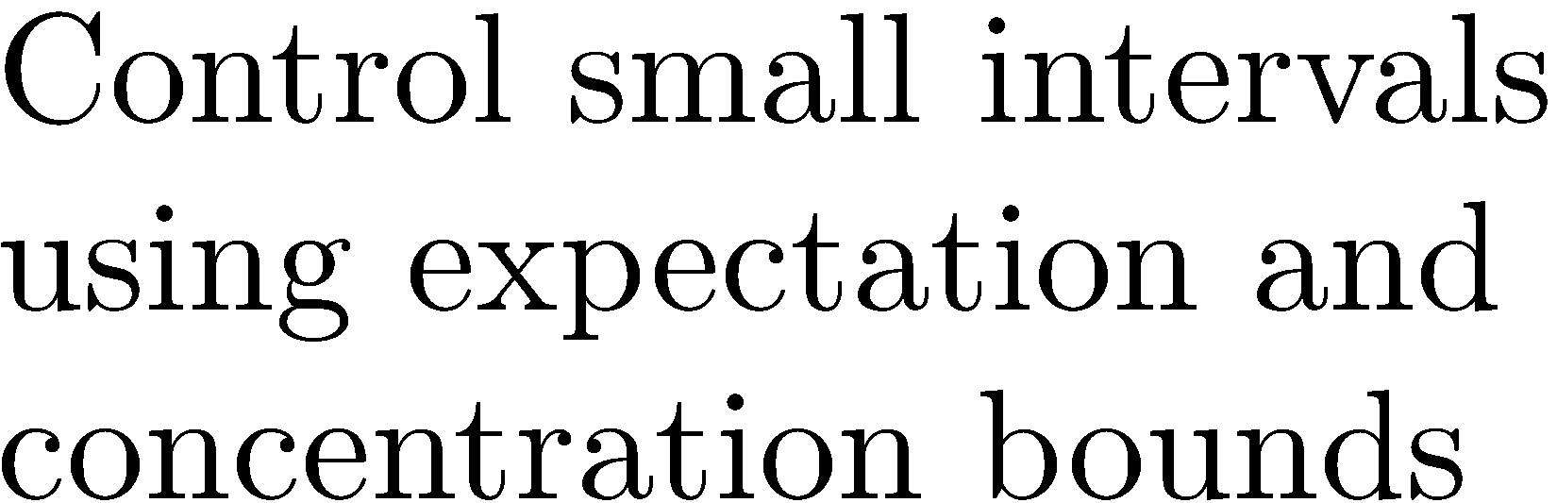
Structure of the Proof

Slide 14
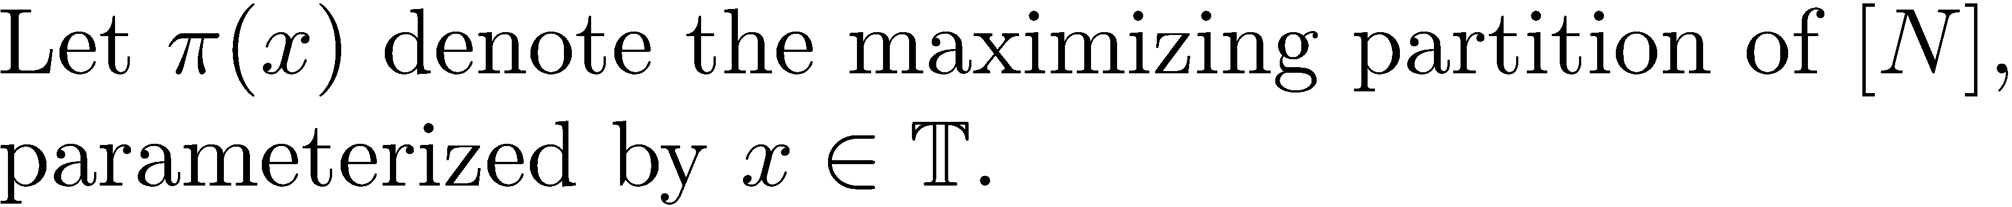
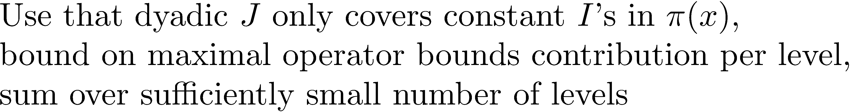

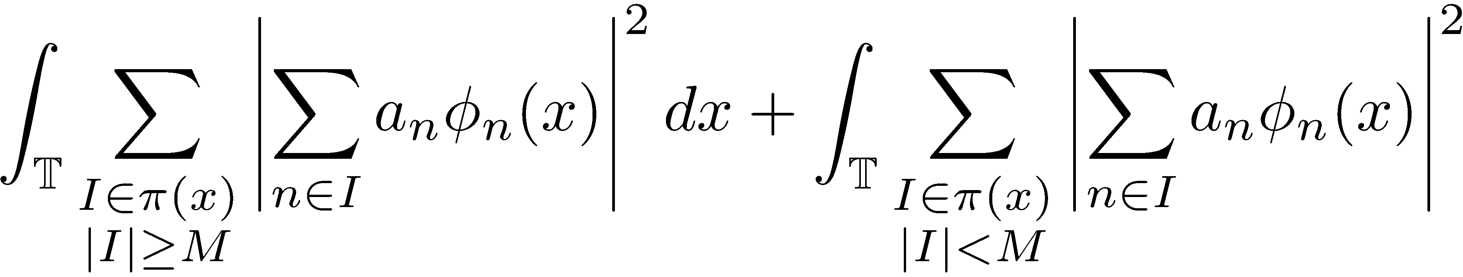
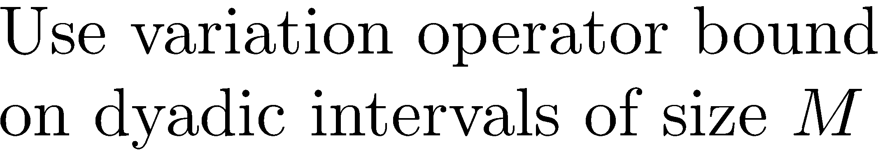
Reducing to a Sub-Level of Intervals
Notes:
Maybe write some of it out on the board?

Slide 15
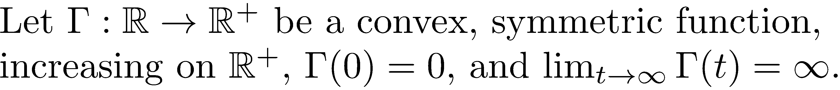
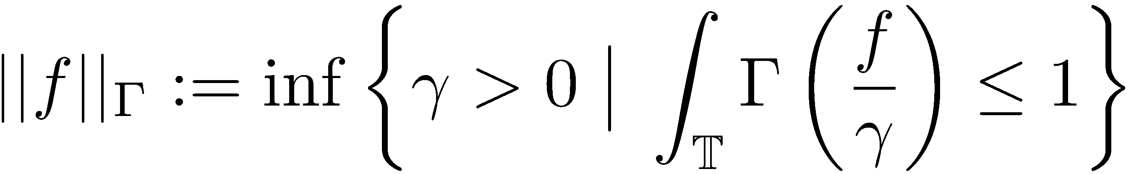
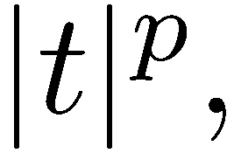


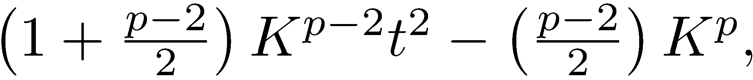

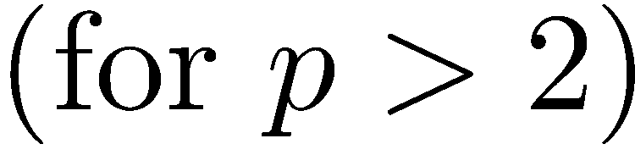
Tool for Controlling Smaller Intervals: Orlicz Space Norms

Slide 16
Orlicz Space Norms

Slide 17
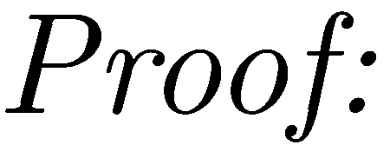
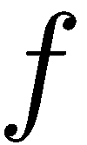
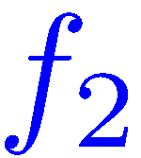
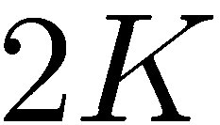
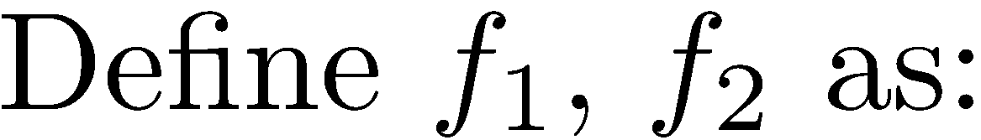
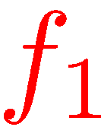

Proof of Decomposition Property
✓
✓

Slide 18
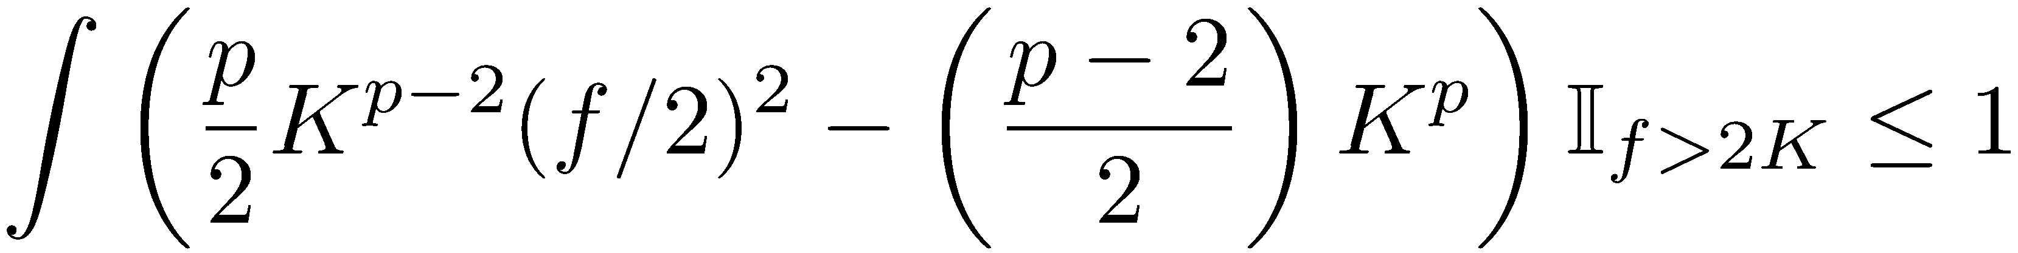
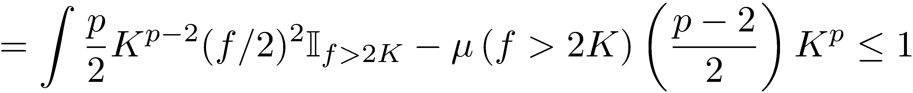
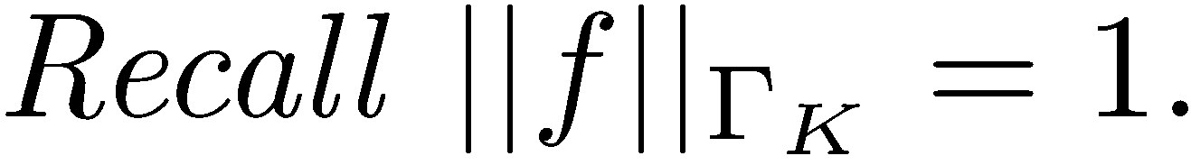
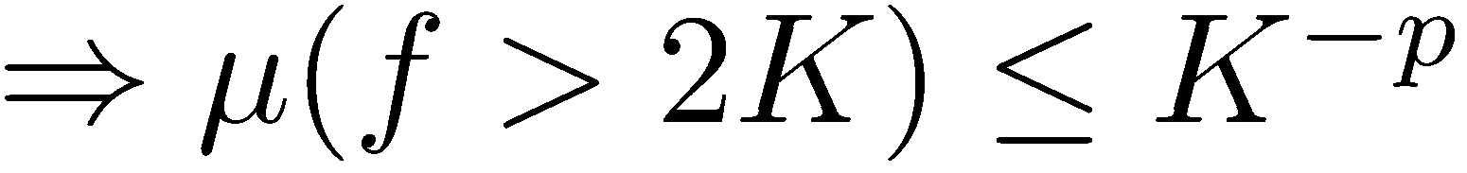

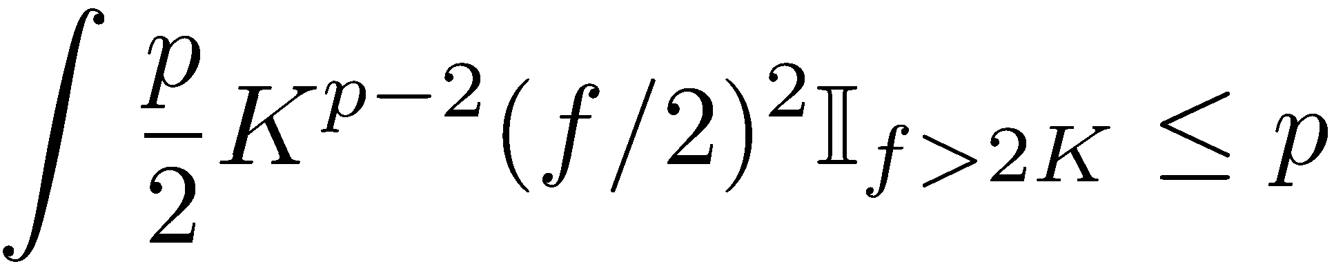
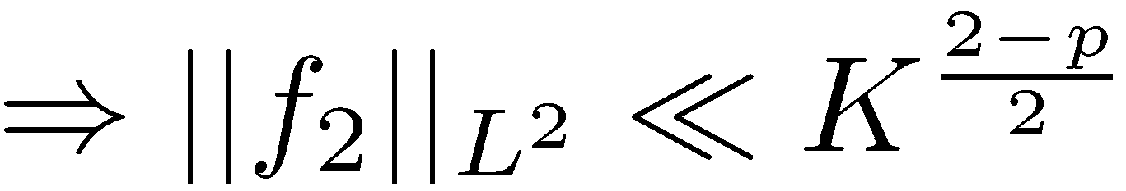
Proof of Decomposition Continued
✓
✓
✓

Slide 19
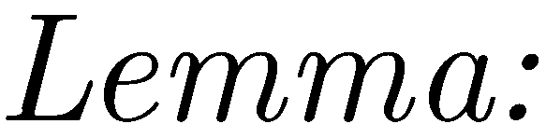
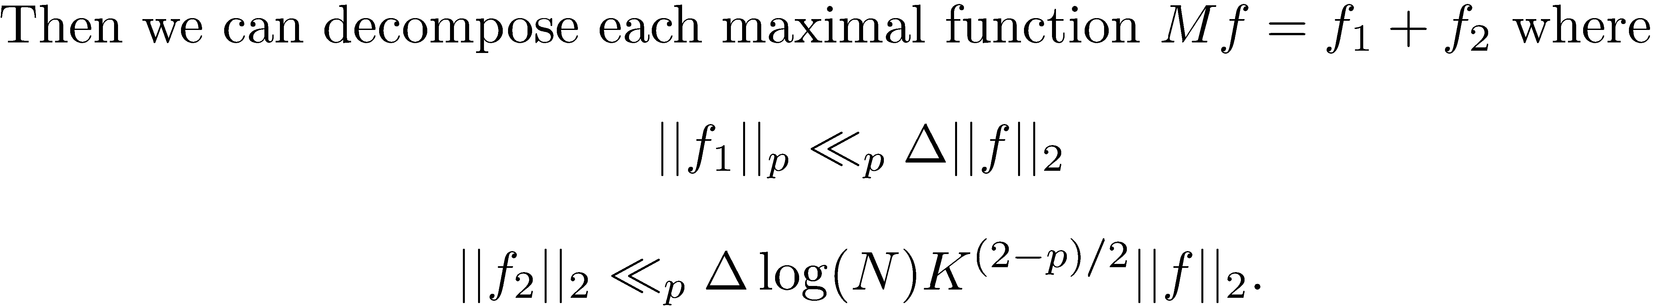
Deriving L^{p}, L² bounds for Decomposition
Notes:
See Lemma 14 on p. 8 of paper

Slide 20
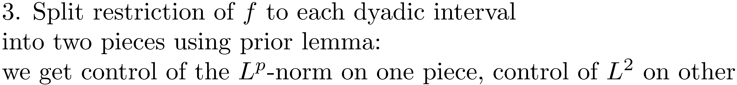
Deriving L^{p}, L² bounds from ¡_{K} (contd.)
Notes:
Maybe explain mass decomposition on the board? Or add another slide somewhere?

Slide 21
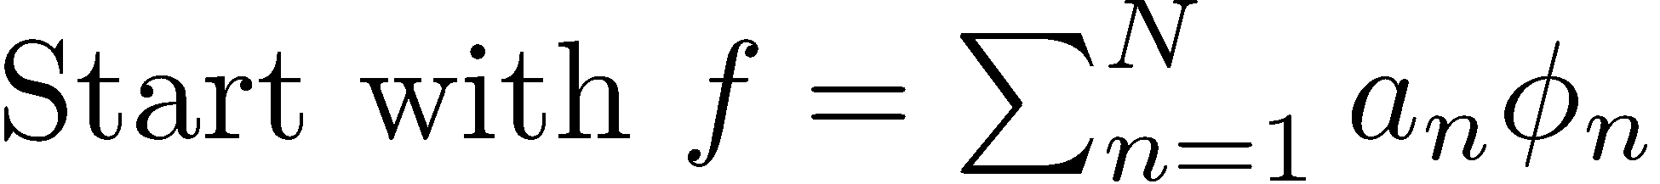
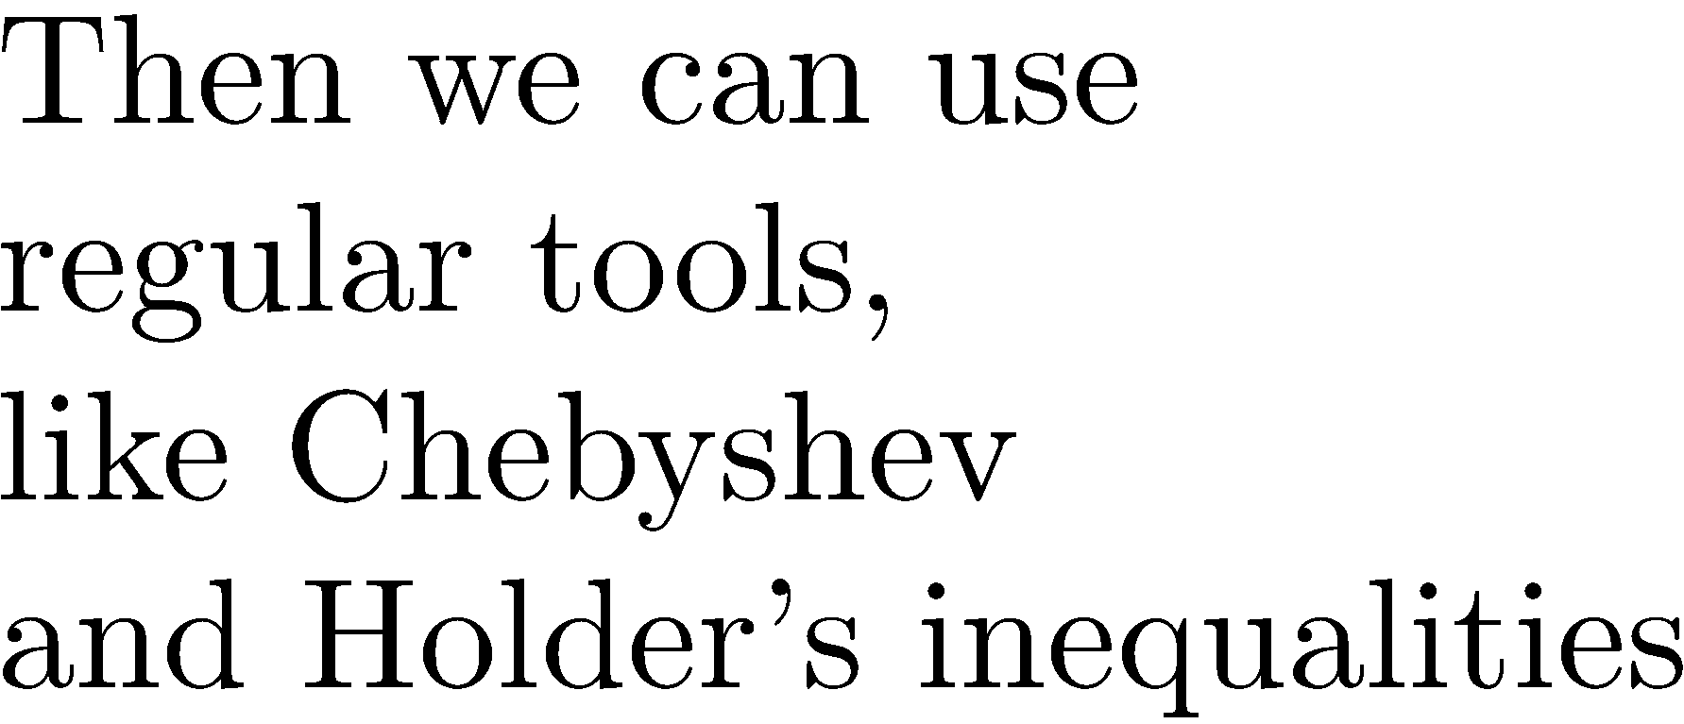
Getting from ¡_{K} Bounds to V² Bounds
Notes:
See lemma 16 on pp. 10-11.

Slide 22
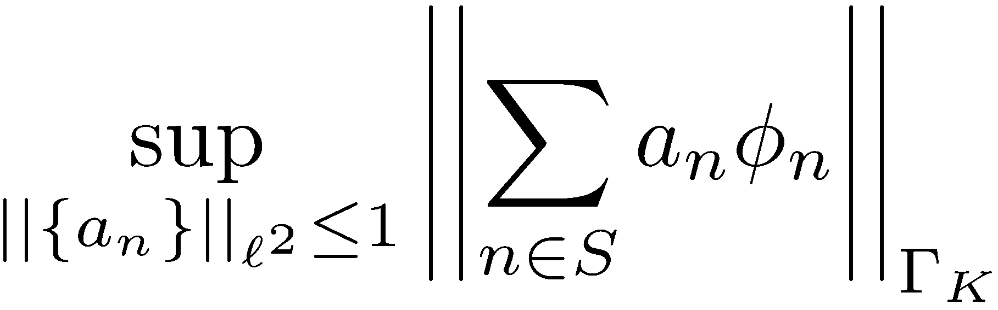
Controlling ¡_{K} Norms by Probabilistic Estimates

Slide 23
Controlling the Supremum of a Random Process

Slide 24
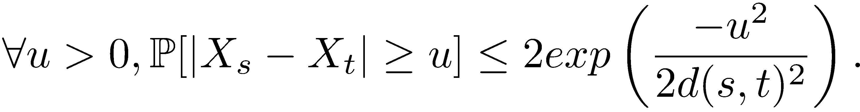
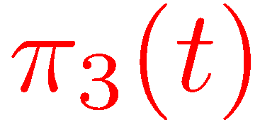
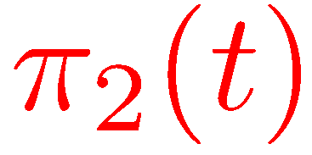
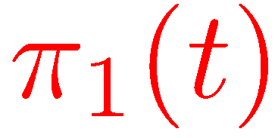

Generic Chaining

Slide 25
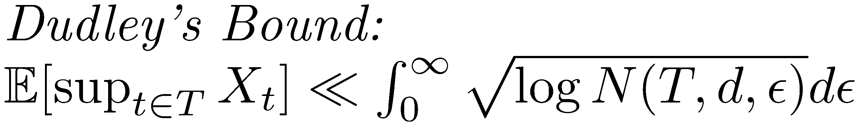
Covering Numbers

Slide 26
Strategy for our Base Estimates

Slide 27
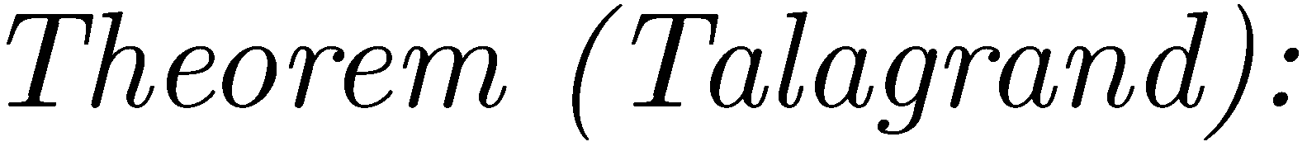


Further Improving the Bounds

Slide 28



High-Level Recap of Proof
Lots of details
swept under
the rug!

Slide 29


Remaining Questions

Slide 30



Other Implications of Variational Quantities

Slide 31




Other Implications of Variational Quantities

Slide 32






Implications of Variational Quantities (contd.)

Slide 33

Thanks!
Questions?

