Slide 1
Maximal Subellipticity
Brian Street

Slide 2
ellipticity
Brian Street

Slide 3
ellipticity
Elliptic PDE are great!
Sharp results are known for very general linear, fully nonlinear, BVP, …
elliptic PDE (rare for PDE)
Maximal Subellipticity generalizes ellipticity
Many results from elliptic PDE generalize—new proofs are needed
Today: What makes elliptic PDE so great and how can we generalize
it?

Slide 4
Background: Results from elliptic PDE
we will generalize
Part I: Linear Theory
Also, what makes elliptic PDE so great?

Slide 5
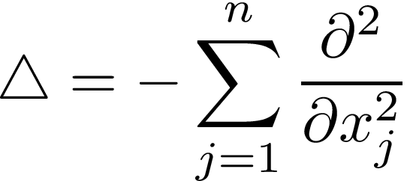

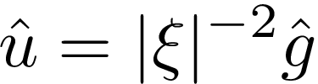

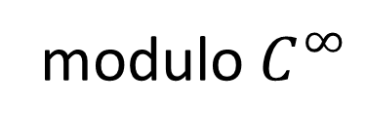
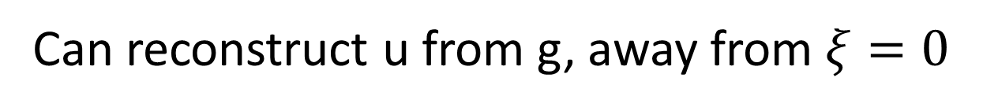
The Laplacian
Can reconstruct u from g, away from $ξ=0$
Can locally invert
modulo $C^{∞}$
For variable coef operators, use pseudo-differential operators

Slide 6
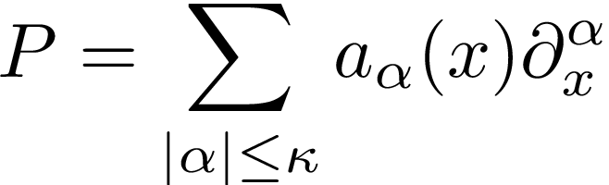
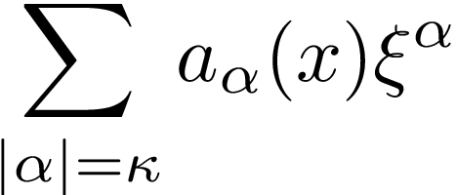
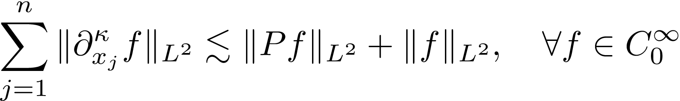
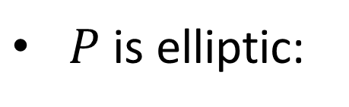

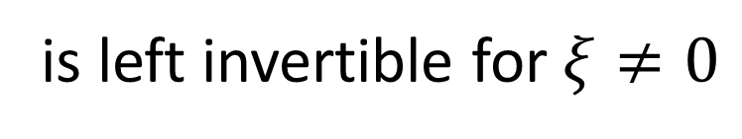
Characterization of Elliptic Operators
Thm: Let
(smooth matrix coef) TFAE (locally):
$P$ is elliptic:
is left invertible for $ξ≠0$
Invertibility
$P^{−1}P≡I$ mod $C^{∞}$, for $P^{−1}$ a pseudo-differential operator of order -$κ$
$∃c>0, ∀α, β,t∈\left(0,1\right]$
Riemannian geometry

Slide 7
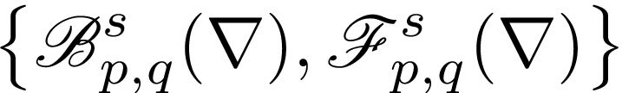
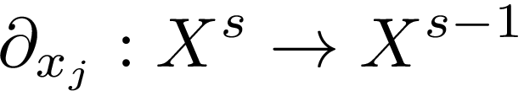


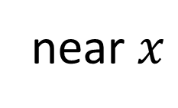

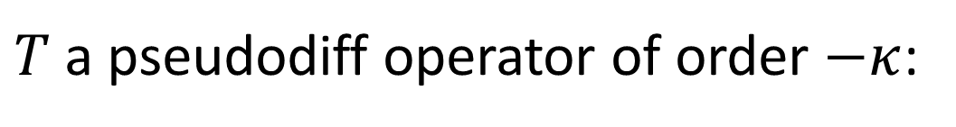





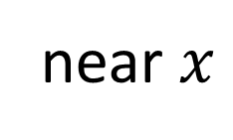






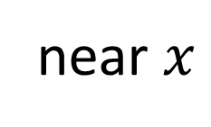



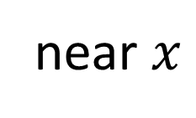

Regularity
$T$ a pseudodiff operator of order $−κ$:
$$g∈$$
$$L_{s}^{p}$$
near $x$
$$⇒$$
$$Tg∈$$
$$L_{s+κ}^{p}$$
near $x$
$$(1<p<∞)$$
$L^{p}$ Sobolev space of order $s$
elliptic
Pseudodiff. op of order $−κ$
$$Pu∈$$
$$L_{s}^{p}$$
near $x$
$$⇔$$
$$u≡P^{−1}Pu∈$$
$$L_{s+κ}^{p}$$
near $x$
$$⇒$$
Same proof works for lots of spaces!
$$X^{s}$$
$$∈$$
$$X^{s}$$
$$X^{s}$$
classical Besov spaces
classical Triebel-Lizorkin spaces

Slide 8
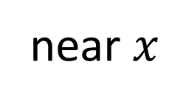


Regularity
$T$ a pseudodiff operator of order $−κ$:
$$g∈$$
$$L_{s}^{p}$$
near $x$
$$⇒$$
$$Tg∈$$
$$L_{s+κ}^{p}$$
near $x$
$$(1<p<∞)$$
elliptic
Invertibility
$$Pu∈$$
near $x$
$$⇔$$
$$u≡P^{−1}Pu∈$$
$$X^{s+κ}$$
near $x$
$$X^{s}$$
$$⇒$$
Same proof works for lots of spaces!
$$X^{s}$$
$$∈$$
classical Besov spaces
classical Triebel-Lizorkin spaces

Slide 9
Linear Maximally Subelliptic Operators

Slide 10
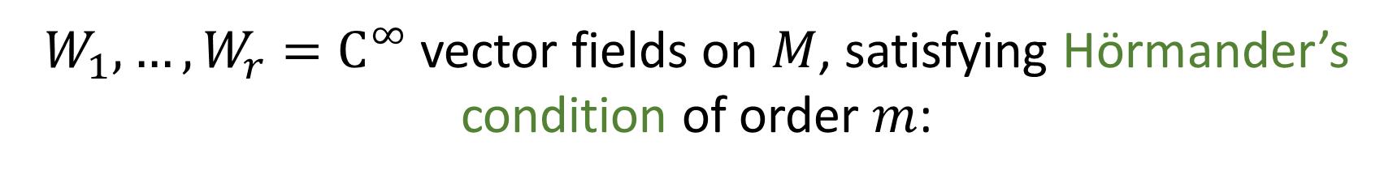
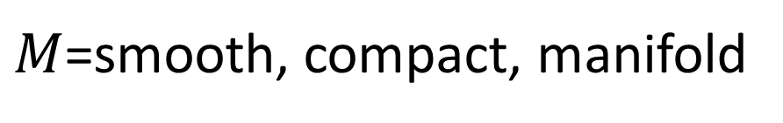
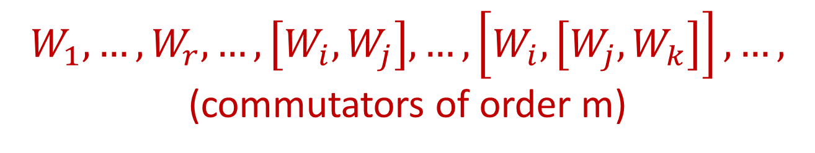
Setting
everything today is local
$M$=smooth, compact, manifold
$W_{1},…,W_{r}=C^{∞}$ vector fields on $M$, satisfying Hörmander’s condition of order $m$:
$$W_{1},…,W_{r},…,\left[W_{i},W_{j}\right],…,\left[W_{i},\left[W_{j},W_{k}\right]\right],…,$$
(commutators of order m)
span the tangent space at every point

Slide 11
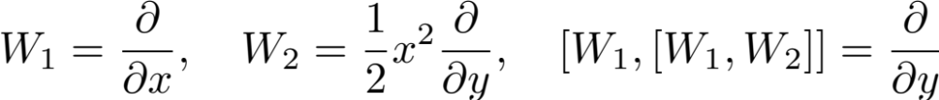
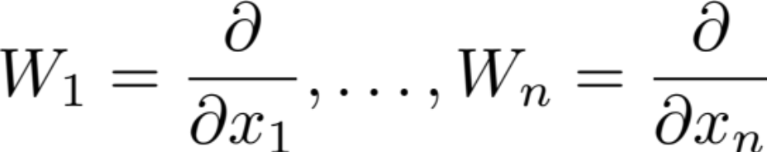
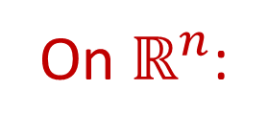
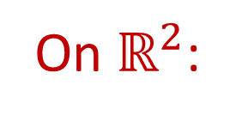
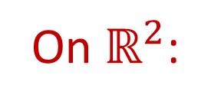
Examples
On $ℝ^{2}$:
order 1
order 2
On $ℝ^{2}$:
order 1
order 3
On $ℝ^{n}$:
(Elliptic Setting)
Notation:

Slide 12
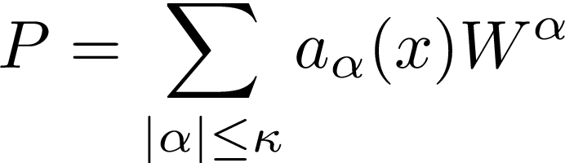


Maximal Subellipticity
every PDO is of this form
ellipticity:
$$||∂_{x_{j}}^{κ}f||_{L^{2}}≲||Pf ||_{L^{2}}+||f||_{L^{2}}$$

Slide 13


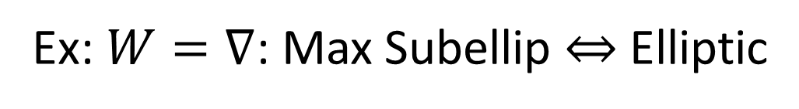
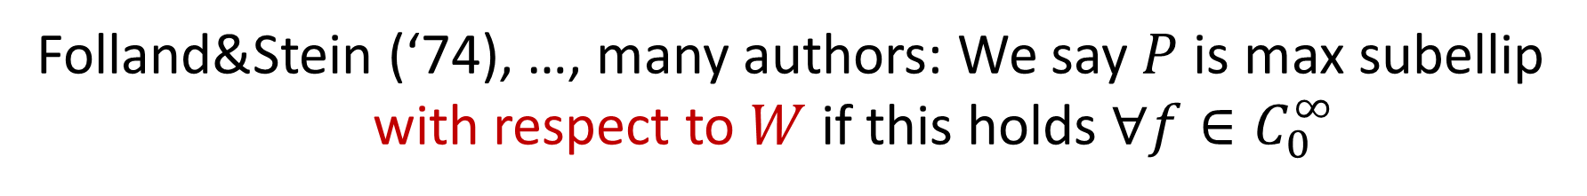
Maximal Subellipticity
Max Subellipticity:
$$||W_{j}^{κ}f||_{L^{2}}≲||Pf ||_{L^{2}}+||f||_{L^{2}}$$
Folland&Stein (‘74), …, many authors: We say $P$ is max subellip
with respect to $W$ if this holds $∀f∈C_{0}^{∞}$
Ex: $W=∇$: Max Subellip $⇔$ Elliptic
Hörmander’s sub-Lapacian
Rothschild-Stein:
is max sub wrt $W$
Ex:
Not elliptic!
Usually, max sub operators are nowhere elliptic
and much more “degenerate”

Slide 14
Versus Ellipticity
Ellipticity is a special case of Maximal Sub (W=$∇$)
Changing W gives a different condition, not a weaker one
Q: When can we prove a result about general maximal sub ops
which specializes to a classical result from the elliptic theory?
A: Surprisingly often!
Major obstacles: Fourier transform is not very useful;
Non-commutative setting
Proofs from elliptic theory do not generalize, but results
often do

Slide 15
History
Aspects of the classical harmonic analysis can be generalized,
depending on the situation
A priori estimates: Hörmander,
Kohn, …, …
Cited thousands of times!
Groups and representation theory: Folland,
, Rothschild
, Rockland, Hulanicki,
Stein
Helffer-Nourrigat, …, …, Fisher-Fermanian Kammerer, …, Androulidakis-Mohsen-Yuncken
Probability: Malliavin, …, …, Stochastic PDE: E, Hairer, Mattingly, …
, Rothschild
, Nagel, Wainger, C. Fefferman,
Singular integrals (today): Folland,
Stein
Phong, Sánchez-Calle, Christ, Jerison, Tao, Wright, Koenig, S., …, …

Slide 16
History
Aspects of the classical harmonic analysis can be generalized,
depending on the situation
A priori estimates: Hörmander,
Kohn, …, …
Stein
Groups and representation theory: Folland,
, Rothschild
, Rockland, Hulanicki,
Helffer-Nourrigat, …, …, Fisher-Fermanian Kammerer, …, Androulidakis-Mohsen-Yuncken
Probability: Malliavin, …, …, Stochastic PDE: E, Hairer, Mattingly, …
Stein
, Nagel, Wainger, C. Fefferman,
Singular integrals (today): Folland,
, Rothschild
Phong, Sánchez-Calle, Christ, Jerison, Tao, Wright, Koenig, S., …, …

Slide 17
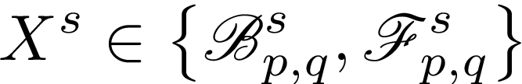

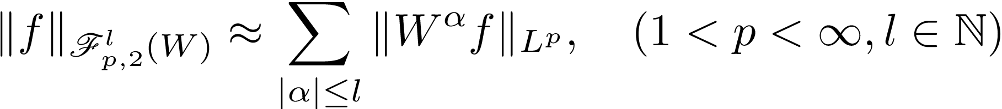







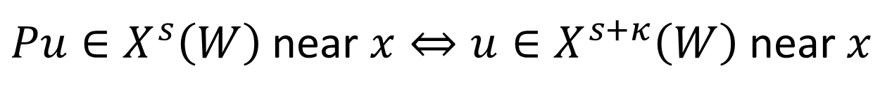

Regularity
can define a generalization
Treat $W_{j}$ as an
operator of order 1
Ex:
Sobolev Spaces!
Many Authors (Folland, Stein, Rothschild,…): For $P$ max sub
$Pu∈X^{s}\left(W\right)$ near $x⇔u∈X^{s+κ}\left(W\right)$ near $x$
Ex:
gain 2 derivatives

Slide 18
Regularity
can define a generalization
Treat $W_{j}$ as an
operator of order 1
Ex:
Sobolev Spaces!
Many Authors (Folland, Stein, Rothschild,…): For $P$ max sub
$Pu∈X^{s}\left(W\right)$ near $x⇔u∈X^{s+κ}\left(W\right)$ near $x$
Ex:
gain 2 derivatives

Slide 19
Regularity
can define a generalization
Treat $W_{j}$ as an
operator of order 1
Ex:
Sobolev Spaces!
Many Authors (Folland, Stein, Rothschild,…): For $P$ max sub
$Pu∈X^{s}\left(W\right)$ near $x⇔u∈X^{s+κ}\left(W\right)$ near $x$
Ex:
gain 2 derivatives

Slide 20

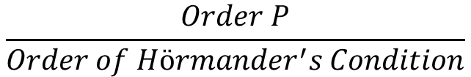
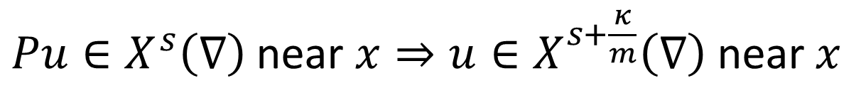
Regularity
can define a generalization
Treat $W_{j}$ as an
operator of order 1
Ex:
Sobolev Spaces!
Many Authors (Folland, Stein, Rothschild,…): For $P$ max sub
$Pu∈X^{s}\left(W\right)$ near $x⇔u∈X^{s+κ}\left(W\right)$ near $x$
gain 1=2/2
Ex:
gain 2 derivatives
Many Authors (Hörmander, Kohn, Stein, Rothschild,…): For $P$ max sub
$Pu∈X^{s}\left(∇\right)$ near $x⇒u∈X^{s+\frac{κ}{m}}\left(∇\right)$ near $x$
$$\frac{Order P}{Order of Hörmander^{′}s Condition}$$
This is sharp!

Slide 21
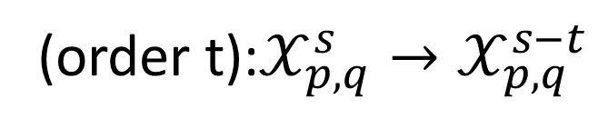
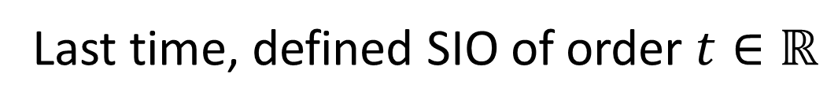
Singular Integral Operators
Last time, defined SIO of order $t∈ℝ$
Filtered algebra: (order s)(order t)=(order t+s)
[(order s),(order t)]=(order t+s)
Not (order t+s-1)!
Proofs from the elliptic theory do not generalize
(order t):$𝒳_{p,q}^{s}→𝒳_{p,q}^{s−t}$

Slide 22

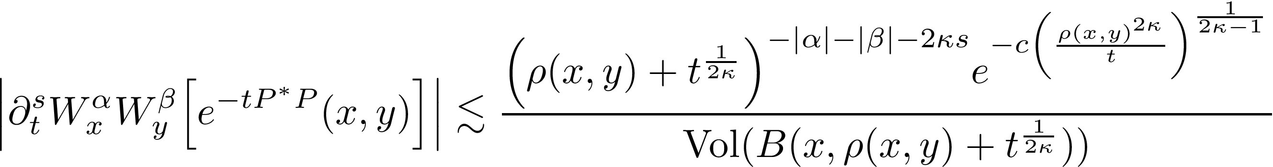
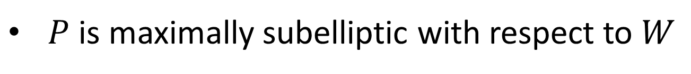

Thm (Many Authors):
TFAE (locally):
$P$ is maximally subelliptic with respect to $W$
Invertibility
$∃$ a singular integral operator, $P^{−1}$, of order $−κ$ with
$∃c>0, ∀α, β,t∈\left(0,1\right]$
Carnot-Carathéodory metric

Slide 23
Previous (unrelated) work on special quasilinear eqns:
Lu, Xu, Capogna, Danielli, Garofalo
, Domokos, Manfredi,
Di Fazio, Fanciullo, Föglein, Marchi, Mukherjee, Zhong,
Citti, Mingione, Ricciotti
Part II: Fully Nonlinear Theory
Some second order fully nonlinear: Martino, Montanari,
Bardi, Goffi, Bhattacharya, Mohammed, Danielli, Garofalo,
Nhieu, Lu, Manfredi, Stroffolini
General fully nonlinear: new

Slide 24
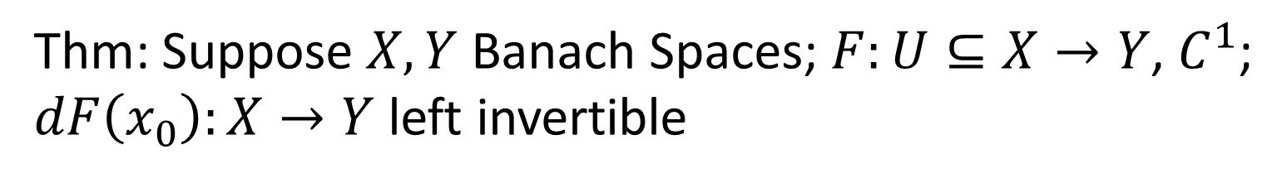
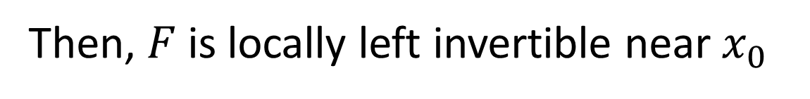
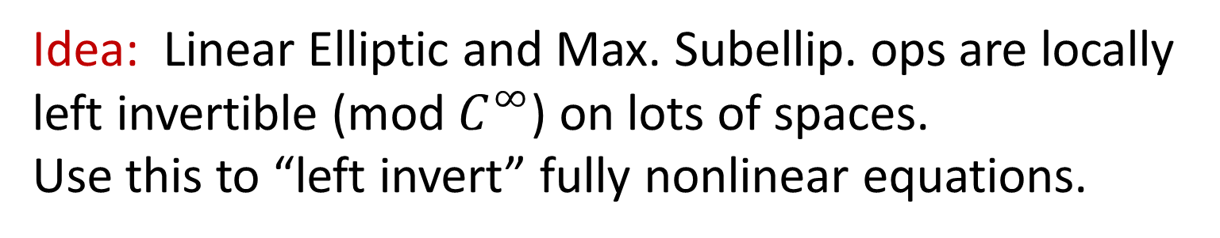
Banach Space Inverse Function Theorem
Thm: Suppose $X,Y$ Banach Spaces; $F:U⊆X→Y$, $C^{1}$;
$dF\left(x_{0}\right):X→Y$ left invertible
Then, $F$ is locally left invertible near $x_{0}$
i.e., $∃G:V⊆Y→X$, $F\left(x_{0}\right)∈V$, $G\left(F\left(x\right)\right)=x$ for $x$ near $x_{0}$
Respectively, invertible, right invertible.
Proof: Contraction Mapping Principle.
Idea: Linear Elliptic and Max. Subellip. ops are locally
left invertible (mod $C^{∞}$) on lots of spaces.
Use this to “left invert” fully nonlinear equations.

Slide 25

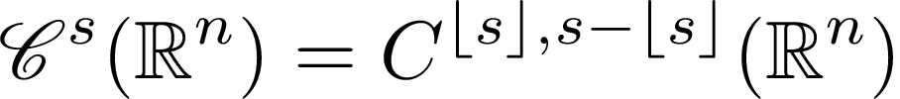
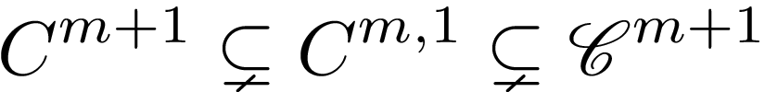

What spaces to use for elliptic eqns?
The Zygmund-Hölder Spaces:
$||f|| =\sup_{x∈ℝ^{n}}{|f\left(x\right)|+\sup_{x∈ℝ^{n}}{\sup_{0≠h∈ℝ^{n}}{{\left|h\right|}^{−1}|f\left(x+h\right)−f\left(x\right)|}} }$
Lipschitz norm
1st order difference

Slide 26



What spaces to use for elliptic eqns?
The Zygmund-Hölder Spaces:
$||f|| =\sup_{x∈ℝ^{n}}{|f\left(x\right)|+\sup_{x∈ℝ^{n}}{\sup_{0≠h∈ℝ^{n}}{{\left|h\right|}^{−1}|f\left(x+2h\right)−2f\left(x+h\right)−f\left(x\right)|}} }$
Zygmund norm
2nd order difference

Slide 27


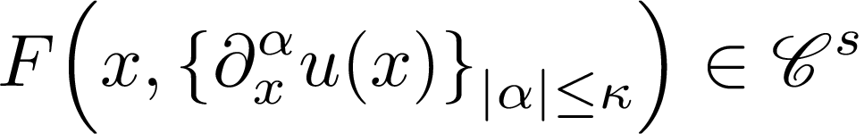

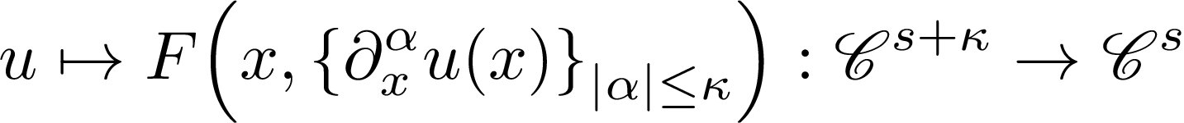
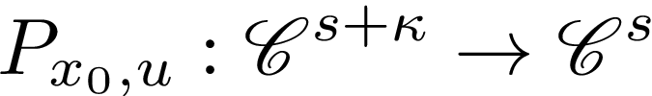

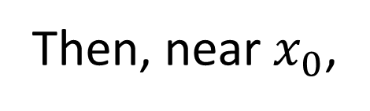
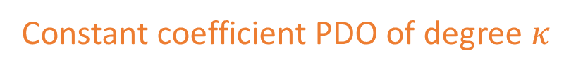
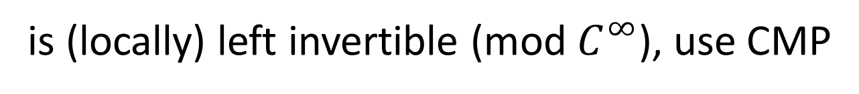
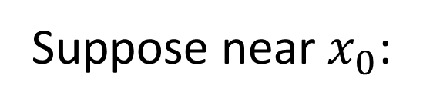
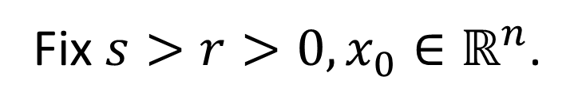

Fully Nonlinear Elliptic PDEs
BIGGER
small
Fix $s>r>0, x_{0}∈ℝ^{n}$.
Suppose near $x_{0}$:
rough
Gain $κ$ derivs
is elliptic
smooth
Then, near $x_{0}$,
Constant coefficient PDO of degree $κ$
Linearize at u and
freeze coefs
smooth
Need Zygmund
spaces
Pf:
$P_{x_{0},u}$ is the derivative at $u$, with coefficients frozen at $x_{0}$
Since
is (locally) left invertible (mod $C^{∞}$), use CMP
to solve for u in
Since $P_{x_{0}, u}$ is not really invertible, need harmonic analysis trickery
Schauder estimates are the case when $F$ is linear in $ζ$

Slide 28










Fully nonlinear Maximally Subelliptic Eqns (S.)
The Zygmund-Hölder Spaces:
Hölder space wrt CC metric $ρ$
Something else!
$∃$ diffeomorphic invariant difference characterization
Every fully nonlinear
PDO is of this form
Fix $s>r>0, x_{0}∈ℝ^{n}$. Suppose near $x_{0}$:
Gain $κ$ derivs
rough
smooth
is maximally subelliptic wrt W
Then, near $x_{0}$,
const coef
polynomial in W
Other spaces:
G. Memana
Proof: The same!
Lots of other results proved in similar ways; e.g., regularity in
and results for vector fields with “formal degrees”
Moral: Once the foundation has been created, proofs can be easy
Comes up in Fokker-Planck

Slide 29







Example: Monge-Ampère
Elliptic:
(
)
symmetric matrix
$$∂_{x_{i}}$$
$$∂_{x_{j}}$$
$$Hu\left(x\right)=$$
$$∂_{x_{i}}$$
$$∂_{x_{j}}$$
$$u\left(x\right)$$
$$u\left(x\right)$$

Slide 30






















Example: Monge-Ampère
(
)
(
$$\frac{1}{2}$$
Gain 2 derivs
$$\frac{1}{2}$$
)
Elliptic:
$$\frac{1}{2}$$
$$∂_{x_{j}}$$
$$\frac{1}{2}$$
$$∂_{x_{i}}$$
$$∂_{x_{j}}$$
$$∂_{x_{j}}$$
$$∂_{x_{i}}$$
$$∂_{x_{i}}$$
$$+$$
$$∂_{x_{j}}$$
$$∂_{x_{i}}$$
$$Hu\left(x\right)=$$
$$+$$
$$Hu\left(x\right)=$$
$$u\left(x\right)$$
$$u\left(x\right)$$
$$u\left(x\right)$$
$$u\left(x\right)$$
If
$$Hu\left(x_{0}\right)>0$$
then
$$u↦\det{Hu}$$
is elliptic at
$$(u,x_{0})$$
positive definite
second order fully nonlinear
Max. Subelliptic (Danielli, Garofalo, Nhieu, Lu, Manfredi, Stroffolini):

Slide 31













Example: Monge-Ampère
(
)
(
$$\frac{1}{2}$$
$$\frac{1}{2}$$
)
Elliptic:
$$\frac{1}{2}$$
$$∂_{x_{j}}$$
$$\frac{1}{2}$$
$$∂_{x_{i}}$$
$$∂_{x_{j}}$$
$$∂_{x_{j}}$$
$$∂_{x_{i}}$$
$$∂_{x_{i}}$$
$$+$$
$$∂_{x_{j}}$$
$$∂_{x_{i}}$$
$$Hu\left(x\right)=$$
$$+$$
$$Hu\left(x\right)=$$
$$u\left(x\right)$$
$$u\left(x\right)$$
$$u\left(x\right)$$
$$u\left(x\right)$$
If
$$Hu\left(x_{0}\right)>0$$
then
$$u↦\det{Hu}$$
is elliptic at
$$(u,x_{0})$$
positive definite
second order fully nonlinear
Max. Subelliptic (Danielli, Garofalo, Nhieu, Lu, Manfredi, Stroffolini):
(
)
Gain 2 derivs
$$\frac{1}{2}$$
$$W_{j}$$
$$\frac{1}{2}$$
$$H_{W}u\left(x\right)=$$
$$W_{i}$$
$$u\left(x\right)$$
$$+$$
$$W_{j}$$
$$W_{i}$$
$$u\left(x\right)$$
If
$$H_{W}u\left(x_{0}\right)>0$$
then
$$u↦\det{H_{W}u}$$
is max subelliptic at
$$(u,x_{0})$$
second order, fully nonlinear, very degenerate
Second order is not important

Slide 32



Toward Boundary Value Problems
$M$ (compact) manifold with boundary
Given PDO
Given PDOs
Given function
Given functions
General theory of elliptic BVP: conditions involving both $P$ and $B_{j}$
Max sub BVP-special cases: Jerison, Kohn-Nirenberg,…,…,…
No general definition......yet. Coming soon: a general theory.

Slide 33


Toward Boundary Value Problems
New important property (Jerison, Kohn-Nirenberg):
$x∈∂M$ is non-characteristic if $∃j,W_{j}\left(x\right)∉T_{x}∂M$
Ex: $∂_{x},x∂_{y}$, $M=\{y≥x^{2}\}$, $\left(0,0\right)$ is characteristic
Elliptic setting: Boundary is always non-characteristic
On the characteristic boundary everything goes wrong!
On the non-characteristic boundary everything goes right!
So far, on the non-characteristic boundary:
Carnot-Carathéodory geometry is well-defined and has scaling maps
Non-characteristic boundary has well-defined Carnot-Carathéodory geometry
Have subelliptic estimates at every scale
Gaussian bounds for heat operators
Good function spaces

Slide 34





Trace Theorems
Classical function spaces:
$H^{s}\left(M\right)→H^{s−\frac{1}{2}}(∂M)$, $s>\frac{1}{2}$, and is right invertible
Not so simple for $L^{p}$…
, and is right invertible
, and is right invertible
For max sub spaces, same is true on non-characteristic boundary
where the boundary has a well-defined CC geometry

Slide 35
Lots more to do!
Given a result from elliptic PDE: Ask, does it generalize?
The statement of the generalization may not be obvious: need the
right geometry, function spaces, operators, etc.
New proof is probably needed, too
This has worked many times already

Slide 36
Thank you!
street@math.wisc.edu

