Slide 1
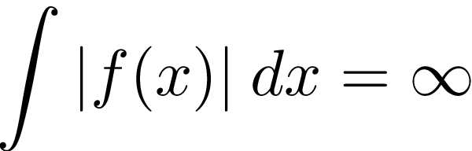
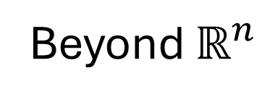
Singular Integrals and PDEs
Beyond $ℝ^{n}$
Brian Street

Slide 2
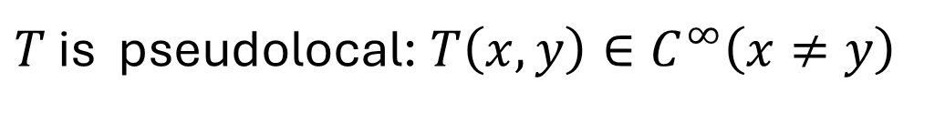

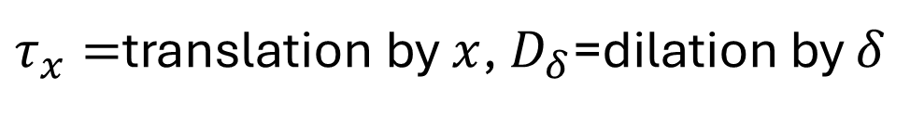

Last Time
$T$=Singular Integral on $ℝ^{n}$: $Tf\left(x\right)=\int{T\left(x,y\right)f\left(y\right)dy}$
$T$ is pseudolocal: $T\left(x,y\right)∈C^{∞}\left(x≠y\right)$
$$T:C_{0}^{∞}→C^{∞}$$
$τ_{x}=$translation by $x$, $D_{δ}$=dilation by $δ$
$D_{δ}τ_{−x}Tτ_{x}D_{δ}$ satisfies the above uniformly in $x,δ$
Bounded on lots of spaces! $L^{p}$ ($1<p<∞$), Sobolev, (Zygmund)-Hölder,
Besov, Triebel-Lizorkin
Contains parametricies for elliptic PDOs
More generally, nilpotent Lie groups with dilations
Carries over (with obvious changes)!
New class of (non-elliptic) PDOs

Slide 3

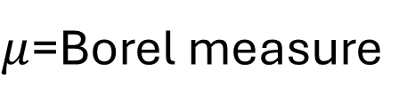

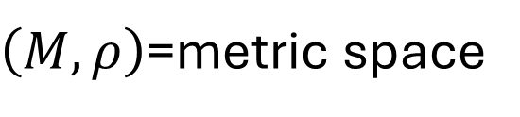
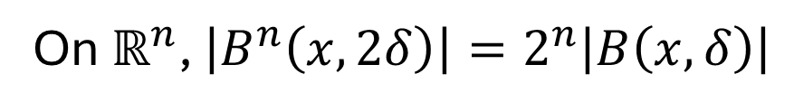
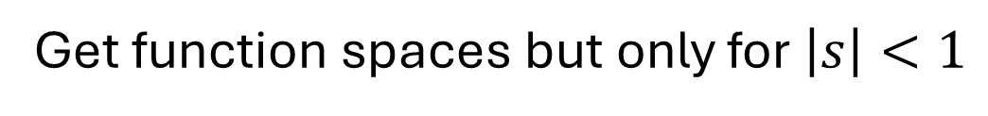
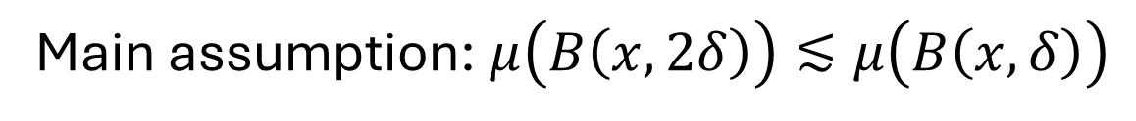
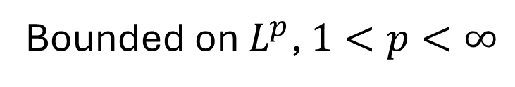
Spaces of homogeneous type (Coifman—Weiss)
$\left(M,ρ\right)$=metric space
$μ$=Borel measure
Main assumption: $μ\left(B\left(x,2δ\right)\right)≲μ\left(B\left(x,δ\right)\right)$
On $ℝ^{n}$, $\left|B^{n}\left(x,2δ\right)\right|=2^{n}\left|B\left(x,δ\right)\right|$
Singular Integral Operator: $Tf\left(y\right)=\int{T\left(x,y\right)f\left(y\right)dμ\left(y\right)}$
$$|T(x,y)|≲μ(B{\left(x,ρ\left(x,y\right)\right)}^{−1}$$
not integrable!
Translation and
dilation invariance!
Also need cancellation
$${\left|x−y\right|}^{−n}$$
Bounded on $L^{p}$, $1<p<∞$
Get function spaces but only for $\left|s\right|<1$
No such thing as infinite smoothness on metric spaces; problem for PDEs

Slide 4
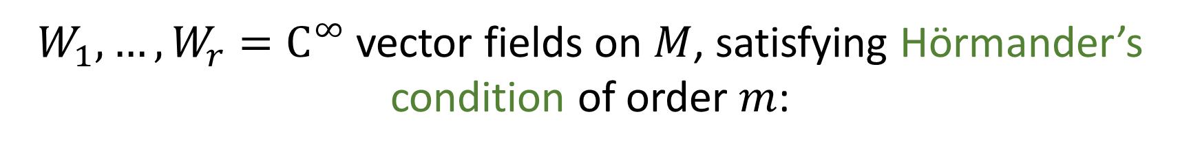
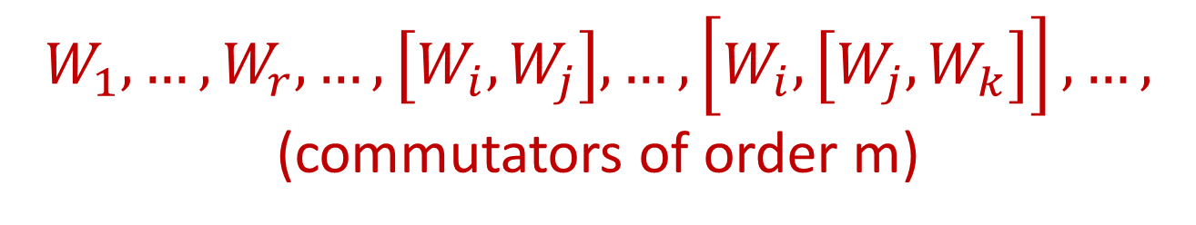
Case Study: Carnot-Carathéodory Geometry
For simplicity
$M$=smooth, compact, manifold, w/o bdry (for now!)
$W_{1},…,W_{r}=C^{∞}$ vector fields on $M$, satisfying Hörmander’s condition of order $m$:
$$W_{1},…,W_{r},…,\left[W_{i},W_{j}\right],…,\left[W_{i},\left[W_{j},W_{k}\right]\right],…,$$
(commutators of order m)
span the tangent space at every point

Slide 5
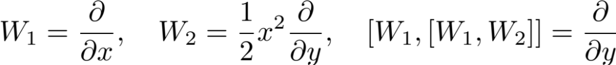
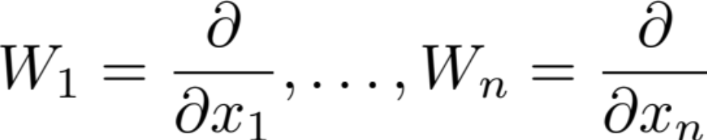
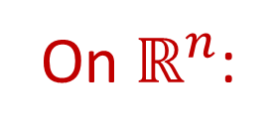
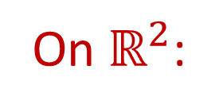
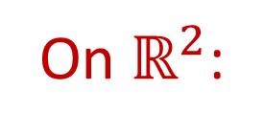
Examples
On $ℝ^{2}$:
order 1
order 2
On $ℝ^{2}$:
order 1
order 3
On $ℝ^{n}$:
(Elliptic Setting)
Notation:

Slide 6
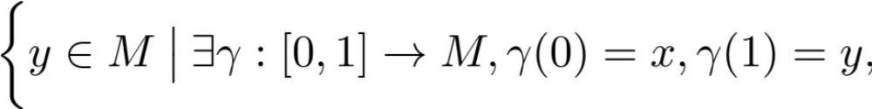

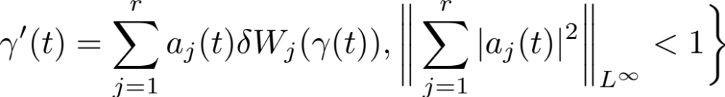


Carnot-Carathéodory Geometry
Nagel, Stein, Wainger:
y
Calderón-Zygmund theory of singular integrals
x
singular integral operators
One approach: Use
of pseudodifferential operators
$$B_{W}\left(x,δ\right)=B_{δW}\left(x,1\right)$$

Slide 7
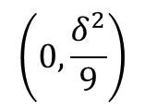





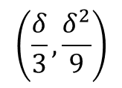
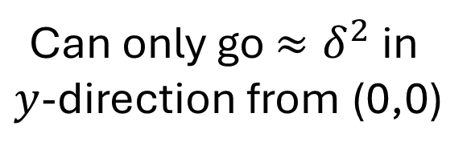
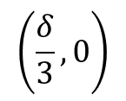

Carnot-Carathéodory Geometry
$$δ∂_{x},δx∂_{y}$$
$$\left(0,\frac{δ^{2}}{9}\right)$$
$$\left(\frac{δ}{3},\frac{δ^{2}}{9}\right)$$
$$δ∂_{x}$$
$$\left[δ∂_{x},δx∂_{y}\right]=δ^{2}∂_{y}$$
$$δx∂_{y}$$
Can only go $≈δ^{2}$ in
$y$-direction from (0,0)
$$≈δ^{2}$$
(0,0)
$$δ∂_{x}$$
$$\left(\frac{δ}{3},0\right)$$

Slide 8
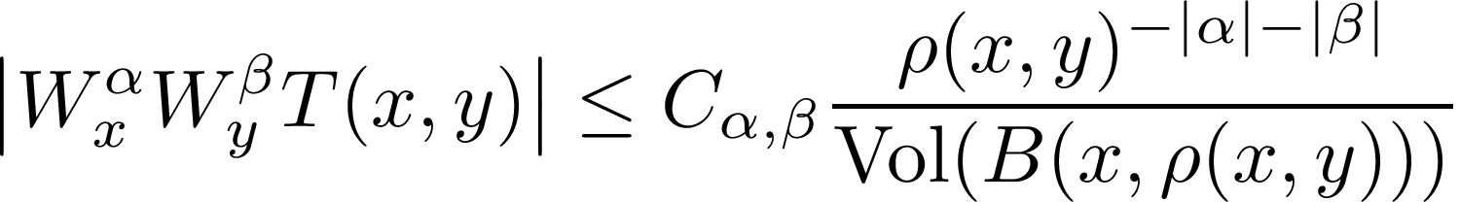
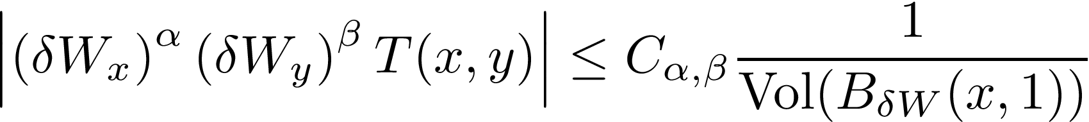
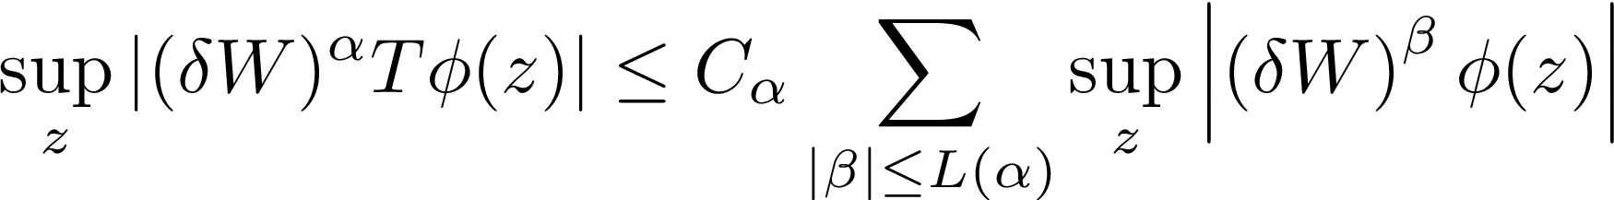
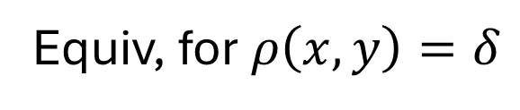
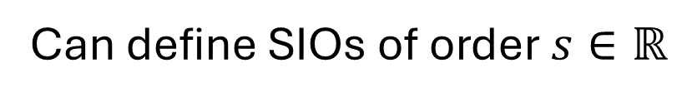




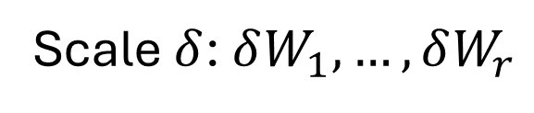
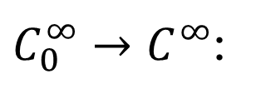
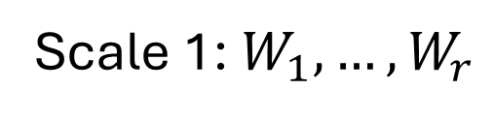
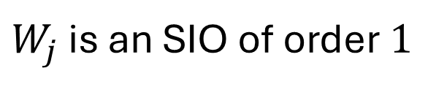
Singular Integral Operators
$$T:C_{0}^{∞}→C^{∞}$$
$$T\left(x,y\right)∈C^{∞}\left(x≠y\right)$$
Uniformly in point and scale
Scale 1: $W_{1},…,W_{r}$
Scale $δ$: $δW_{1},…,δW_{r}$
We say $T:C_{0}^{∞}→C^{∞}$ is a SIO of order $0$ if:
Pseudolocal:
Equiv, for $ρ\left(x,y\right)=δ$
$C_{0}^{∞}→C^{∞}$:
$$∀φ∈C_{0}^{∞}\left(B\left(x,δ\right)\right)$$
Can define SIOs of order $s∈ℝ$
$W_{j}$ is an SIO of order $1$

Slide 9
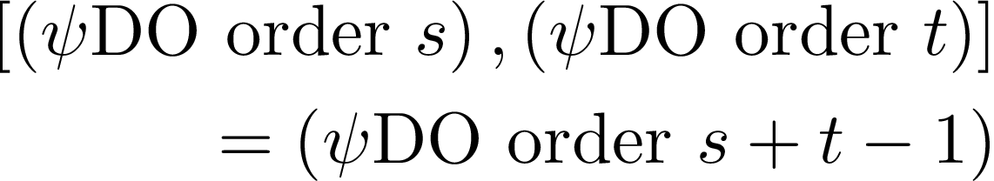

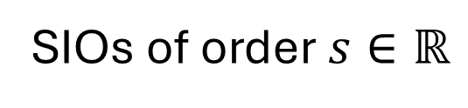
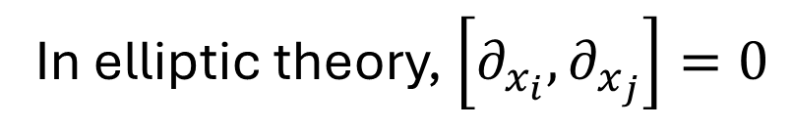
Singular Integral Operators
SIOs of order $s∈ℝ$
Filtered algebra: (order s)(order t)=(order t+s)
[(order s),(order t)]=(order t+s)
Not (order t+s-1)!
Not a bug: $\left[W_{j},W_{k}\right]=$(order 2)
In elliptic theory, $\left[∂_{x_{i}},∂_{x_{j}}\right]=0$
Elliptic theory is commutative; proofs from the elliptic theory don’t generalize
Fourier transform is not as useful
Many results do generalize

Slide 10
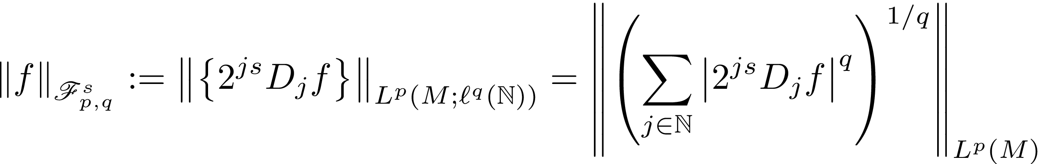
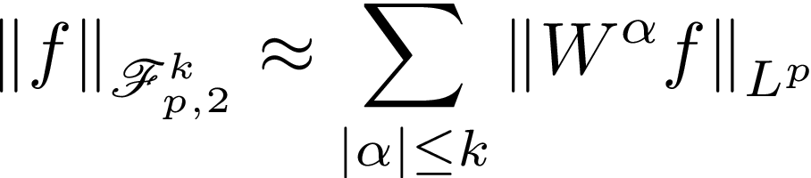
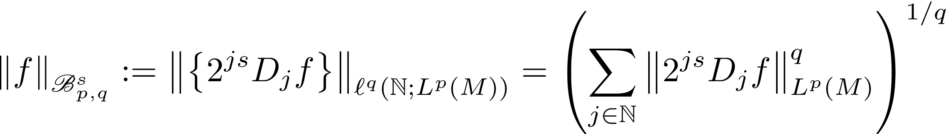
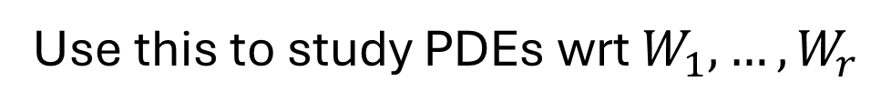
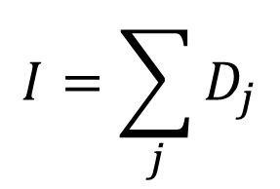
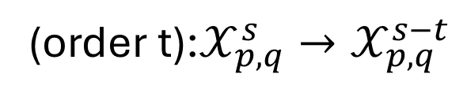
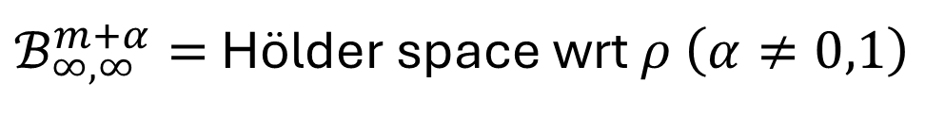
Function Spaces
Good theory of SIOs ⇔ good theory of function spaces
$$I=\sum_{j}{D_{j}}$$
Can define operators $D_{j}$ generalizing the Euclidean case
$ℬ_{∞,∞}^{m+α}=$ Hölder space wrt $ρ$ $\left(α≠0,1\right)$
(order t):$𝒳_{p,q}^{s}→𝒳_{p,q}^{s−t}$
Function spaces which generalize the classical spaces to this geometry $∀s$
Not just a metric space: we have smoothness!
Use this to study PDEs wrt $W_{1},…,W_{r}$

Slide 11
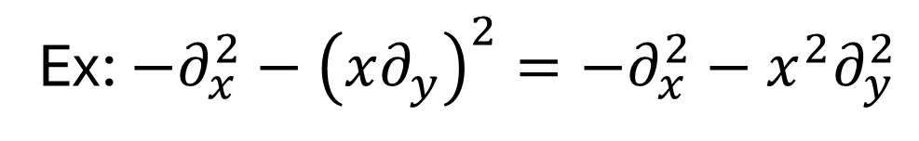
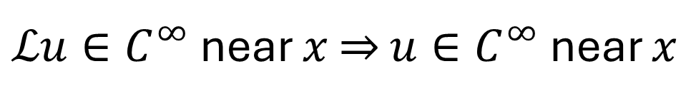

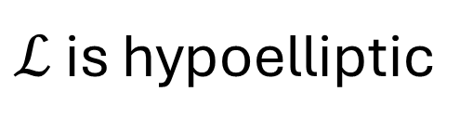
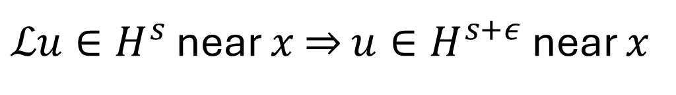
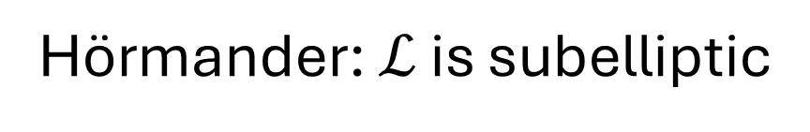
Hörmander’s sub-Laplacian
Not elliptic!
$$ℒ=−W_{1}^{2}−W_{2}^{2}−⋯−W_{r}^{2}$$
Ex: $−∂_{x}^{2}−{\left(x∂_{y}\right)}^{2}=−∂_{x}^{2}−x^{2}∂_{y}^{2}$
Usually nowhere elliptic
Hörmander: $ℒ$ is subelliptic
$ℒu∈H^{s}$ near $x$ ⇒ $u∈H^{s+ε}$ near $x$
$ℒ$ is hypoelliptic
$ℒu∈C^{∞}$ near $x$ ⇒ $u∈C^{∞}$ near $x$
In elliptic case, needed only this and translation
and dilation invariance
There are no translations or dilations!
Up next, a quantitative analog which works

Slide 12
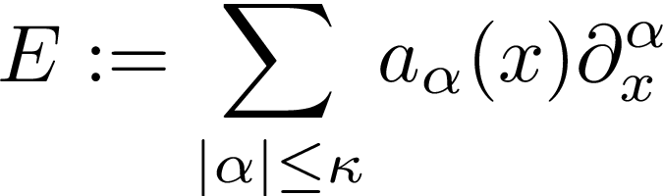
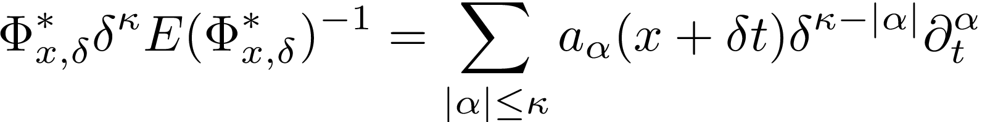

Translations and Dilations
Elliptic:
Elliptic uniformly in $δ$
Small scale ⟹ Unit scale
High frequency ⟹ Low frequency

Slide 13
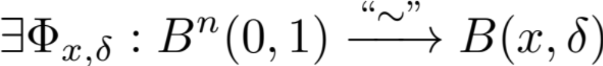




Scaling
Nagel, Stein, Wainger:
$Y_{j}^{x,δ}≔Φ_{x,δ}^{∗}δW_{j}$ smooth vector fields on $B^{n}\left(0,1\right)$, uniformly in $\left(x,δ\right)$
I.e., ${\left\|Y_{j}^{x,δ}\right\|}_{C^{m}}$ bounded uniformly in $\left(x,δ\right)$
The $Y_{j}^{x,δ}$ are not too large
$Y_{j}^{x,δ}$ satisfy Hörmander’s condition, uniformly in $\left(x,δ\right)$
Some determinant
is bounded below
Take commutators up to order $m$, those span the tangent space uniformly
The $Y_{j}^{x,δ}$ are not too small
Cor: $\left|\text{det} dΦ_{x,δ}\left(t\right)\right|≈{\text{Vol}\left(B\left(x,δ\right)\right)}^{}$
Later work by Fefferman&Phong, Tao&Wright, Stovall&S., L. Yao&S.

Slide 14


Unit Ball for $δW_{1},…,δW_{r}$
=CC ball, radius $δ$
$$δW$$
x

Slide 15



Unit Ball for $δW_{1},…,δW_{r}$
=CC ball, radius $δ$
$$Φ_{x,δ}$$
x

Slide 16
At each scale: Atlas which sees it as unit scale
Unit Ball for $δW_{1},…,δW_{r}$
=CC ball, radius $δ$
Euclidean Ball
radius 1
$$Φ_{x,δ}$$
x
Results at
every scale
Calculus:
Hörmander, Kohn,…

Slide 17






Hörmander’s sub-Laplacian
$$ℒ=−W_{1}^{2}−W_{2}^{2}−⋯−W_{r}^{2}$$
$$Tℒ,ℒT≡I \text{mod} C^{∞}$$
order -2
WTS: if $ρ\left(x,y\right)≈δ$, then
$ρ\left(x,y\right)≈δ$ $⇔$ $\left|Φ_{x,δ}^{−1}\left(y\right)\right|≈1$
WTS: if $\left|u\right|≈1$, then
uniformly smooth
STS:
STS: $Φ_{x,δ}^{∗}δ^{−2}T{\left(Φ_{x,δ}\right)}_{∗}\left(v,u\right)∈C^{∞}\left(u≠v\right)$ uniformly in $\left(x,δ\right)$

Slide 18









Hörmander’s sub-Laplacian
$$ℒ=−W_{1}^{2}−W_{2}^{2}−⋯−W_{r}^{2}$$
$$Tℒ,ℒT≡I \text{mod} C^{∞}$$
$$\left(δ^{2}ℒ\right)\left(δ^{−2}T\right)≡I$$
$$δ^{2}ℒ=−{\left(δW_{1}\right)}^{2}−⋯−{\left(δW_{r}\right)}^{2}$$
$$ℒ^{x,δ}≔{Φ_{x,δ}^{∗}δ^{2}ℒ\left(Φ_{x,δ}\right)}_{∗}=−{\left(Y_{1}^{x,δ}\right)}^{2}−⋯−{\left(Y_{r}^{x,δ}\right)}^{2}$$
Hörmander vector fields
uniformly in $x,δ$
Hörmander: $ℒ^{x,δ}$ is subelliptic uniformly in $x,δ$
Since $ℒ^{x,δ}Φ_{x,δ}δ^{−2}T{\left(Φ_{x,δ}\right)}_{∗}≡\text{I} \text{mod} C^{∞}$
have $Φ_{x,δ}δ^{−2}T{\left(Φ_{x,δ}\right)}_{∗}\left(v,u\right)∈C^{∞}\left(v≠u\right)$ uniformly in $x,δ$
This is what we wanted to show! $T$ is an SIO of order $−2$.
Conclude: $ℒu∈𝒳_{p,q}^{s}⇒u∈𝒳_{p,q}^{s+2}$
$$ℒu∈L_{loc}^{p}⇒W_{i}W_{j}u∈L_{loc}^{p},1<p<∞$$

Slide 19



Maximal Subellipticity
Elliptic: E.g., $△$
Maximally Subelliptic: E.g., $−W_{1}^{2}−⋯−W_{r}^{2}$
A general PDO can be written as $P\left(∂_{x_{1}},…,∂_{x_{n}}\right)$ (smooth coefficients)
By Hörmander’s condition, a general PDO can be written as $Q\left(W_{1},…,W_{r}\right)$
non-comm poly
Hormander’s condition is exactly that $∂_{x_{j}}$ can be written as a poly in $W$
Is there a theory of PDEs for general $Q\left(W_{1},…,W_{r}\right)$ which
specializes to the elliptic theory when $W_{j}=∂_{x_{j}}$?
Yes! Maximal subellipticity…next time
Linear, fully nonlinear, BVP, etc…

Slide 20
Parallel Parking

Slide 21


Slide 22


Slide 23


Slide 24


Slide 25


Slide 26
Thank you!
street@math.wisc.edu

