Slide 1
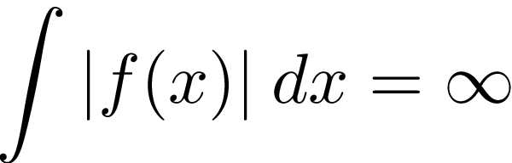
Singular Integrals and PDEs
Brian Street

Slide 2
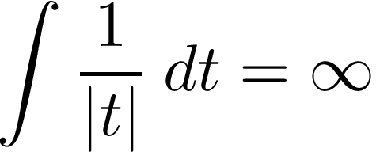
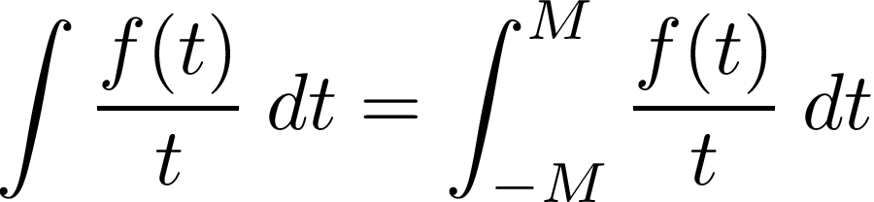
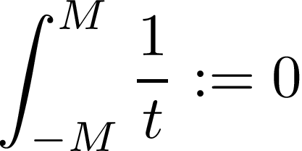

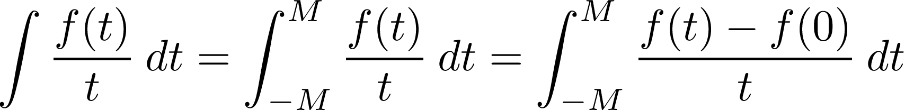


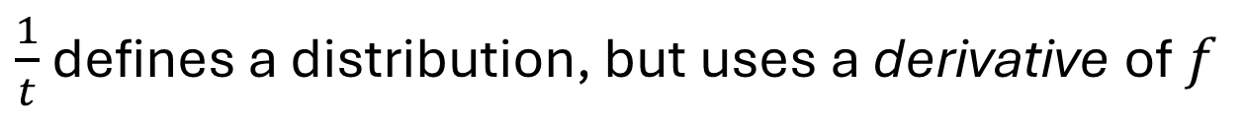


Hilbert Transform
but $\frac{1}{t}$ still defines a distribution
Let $f∈C_{0}^{∞}\left(−M,M\right)$ want to define
Since $\frac{1}{t}$ is odd, set:
bounded by ${\left\|f\right\|}_{C^{1}}$ (MVT)
$\frac{1}{t}$ defines a distribution, but uses a derivative of $f$

Slide 3
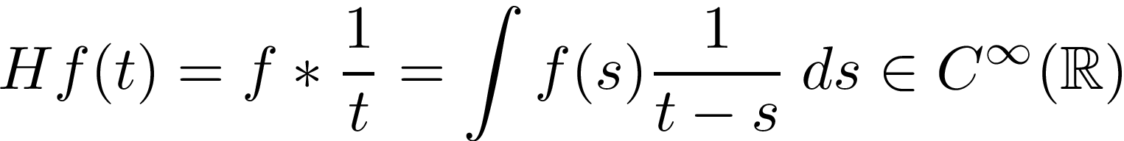

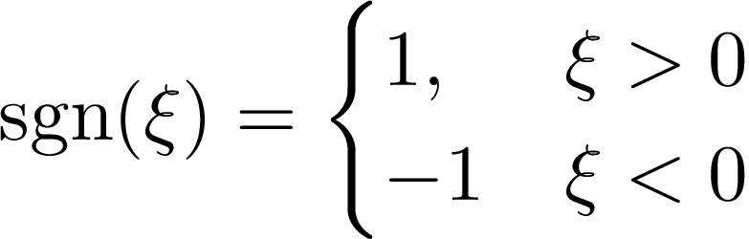






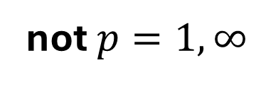
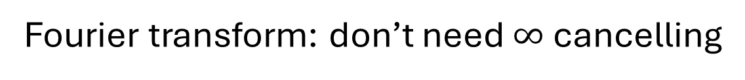
Hilbert Transform
$$D_{δ}f\left(t\right)=f\left(δt\right)$$
$$τ_{x}f\left(t\right)=f\left(t+x\right)$$
$$D_{δ^{−1}} HD_{δ} = H = τ_{−x}Hτ_{x}$$
Thm (Hilbert, Weyl, Schur, Riesz, Besicovitch, Titchmarsh, Marcinkiewicz):
$$H:L^{p}\left(ℝ\right)→L^{p}\left(ℝ\right)$$
$$1<p<∞$$
not $p=1,∞$
$$\hat{Hf}\left(ξ\right)=C\text{sgn}\left(ξ\right)\hat{f}\left(ξ\right)$$
Fourier transform: don’t need $∞$ cancelling
Everything is easier with FT! But impedes generalizations….

Slide 4




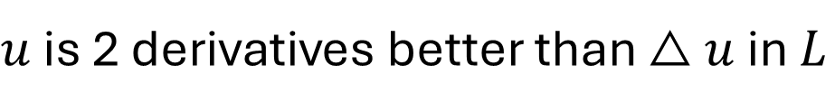



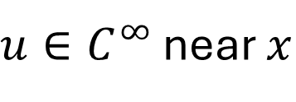


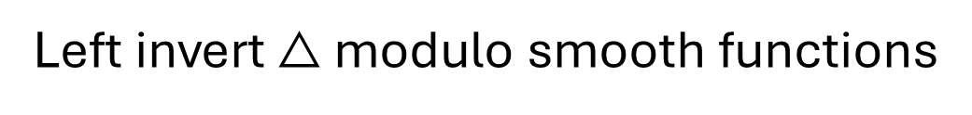


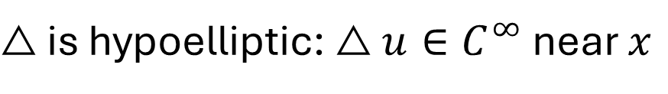




Elliptic PDEs
$$△u=f$$
$$\hat{f}\left(ξ\right)=\hat{△u}\left(ξ\right)={\left|ξ\right|}^{2} \hat{u}\left(ξ\right)$$
$$\hat{u}\left(ξ\right)={\left|ξ\right|}^{−2}\hat{f}\left(ξ\right)$$
Left invert $△$ modulo smooth functions
$$p$$
$$ξ_{i}ξ_{j}\hat{u}=ξ_{i}ξ_{j}{\left|ξ\right|}^{−2}\hat{f}∈L^{2}$$
$$2$$
$$p$$
$$△u∈$$
$$L_{\text{loc}}$$
$$∂_{x_{i}}∂_{x_{j}}u∈$$
$$2$$
$$L_{\text{loc}}$$
$$1<p<∞$$
$u$ is 2 derivatives better than $△u$ in $L$
$$p$$
$$2$$
Same is true for lots of function spaces (Sobolev, Hölder)
$△$ is subelliptic: $u$ is smoother than $△u$ (locally)
$△$ is hypoelliptic: $△u∈C^{∞}$ near $x$
$u∈C^{∞}$ near $x$
Variable coefficient elliptic operators: Calculus of pseudodifferential ops.
Beyond ellipticity: lots of generalizations, but there is a limit to the F.T.
If your op doesn’t respect the group $ℝ^{n}$, the F.T. doesn’t respect your op

Slide 5

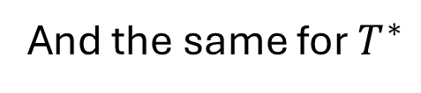
Singular Integrals on $ℝ^{n}$
$$Tf\left(x\right)=\int{T\left(x,y\right)f\left(y\right)dy}$$
$$T:C_{0}^{∞}\left(ℝ^{n}\right)→C^{∞}\left(ℝ^{n}\right)$$
Distributional kernel
$T$ is pseudolocal:
$U∩V=∅$
$$f↦Tf{\left.​\right|}_{V}:ℰ^{′}\left(U\right)→C^{∞}\left(V\right)$$
Equiv: $T\left(x,y\right)∈C^{∞}\left(\{x≠y\}\right)$
$D_{δ^{−1}}τ_{−x}Tτ_{x}D_{δ}$ satisfy the above uniformly in $x,δ$
And the same for $T^{∗}$
$$R=1,z =0$$
$$x=0,\left|x−y\right|=1$$
Defn: $T:C_{0}^{∞}\left(ℝ^{n}\right)→C^{∞}\left(ℝ^{n}\right)$ is a singular integral if
(Growth): $\left|∂_{x}^{α}∂_{y}^{β}T\left(x,y\right)\right|≤C_{α,β}{\left|x−y\right|}^{−n−\left|α\right|−\left|β\right|}$
not integrable (singular integral)
(Cancellation): $∀φ∈C_{0}^{∞}\left(B^{n}\left(1\right)\right)$,
And the same for $T^{∗}$
SIOs form an algebra, bounded on lots of spaces like $L^{p},1<p<∞$

Slide 6
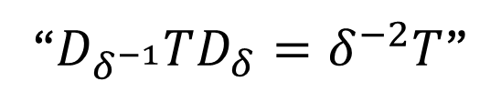
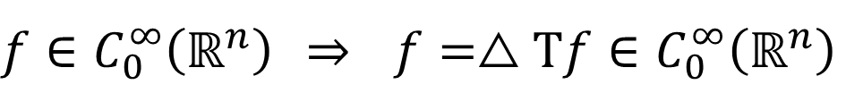


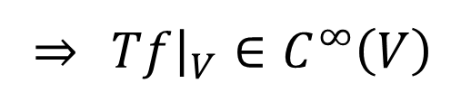
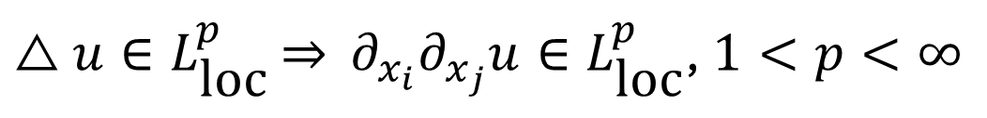

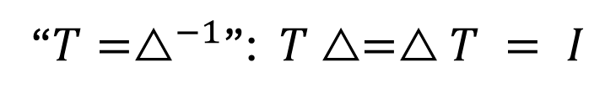

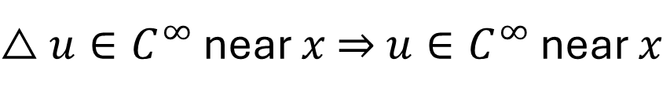


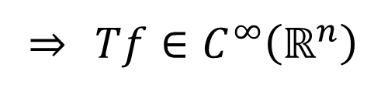
$△$ on $ℝ^{n}$ without Fourier Transform
$$△=−∂_{x_{1}}^{2}−∂_{x_{2}}^{2}−⋯−∂_{x_{n}}^{2}$$
$$D_{δ^{−1}}△D_{δ}=δ^{2}△$$
$$τ_{−x}△τ_{x}=△$$
“$T=△^{−1}$”: $T△=△T = I$
“$D_{δ^{−1}}TD_{δ}=δ^{−2}T$”
$$τ_{−x}Tτ_{x}=T$$
$$D_{δ^{−1}}∂_{x_{i}}∂_{x_{j}}TD_{δ}=∂_{x_{i}}∂_{x_{j}}T$$
$△u∈C^{∞}$ near $x$ ⇒ $u∈C^{∞}$ near $x$
(hypoellipticity)
$U∩V=∅$, $f∈ℰ^{′}\left(U\right)$ ⇒ $△Tf{\left.​\right|}_{V}=f{\left.​\right|}_{V}=0∈C^{∞}\left(V\right)$
⇒ $Tf{\left.​\right|}_{V}∈C^{∞}\left(V\right)$
$f∈C_{0}^{∞}\left(ℝ^{n}\right)$ ⇒ $f=△Tf∈C_{0}^{∞}\left(ℝ^{n}\right)$
⇒ $Tf∈C^{∞}\left(ℝ^{n}\right)$
Combine with translation and dilation invariance: $∂_{x_{i}}∂_{x_{j}}T$ is an SIO
Conclude: $u$ is two derivatives better than $△u$ in lots of function spaces, e.g.,
$△u∈L_{\text{loc}}^{p}$ ⇒ $∂_{x_{i}}∂_{x_{j}}u∈L_{\text{loc}}^{p}$, $1<p<∞$
Only used hypoellipticity and
(quantitative)
translation and dilation invariance

Slide 7
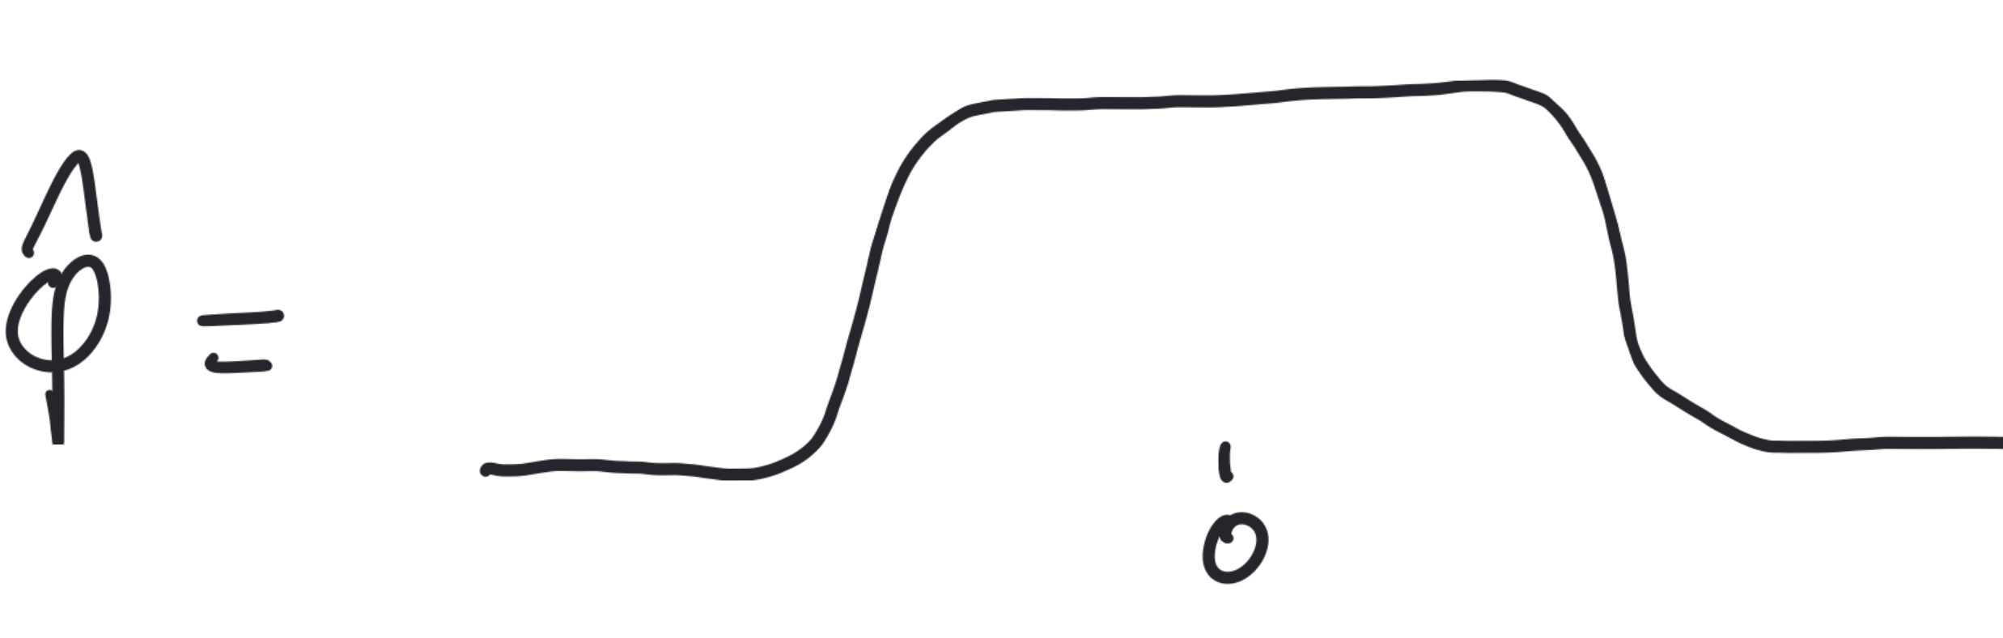
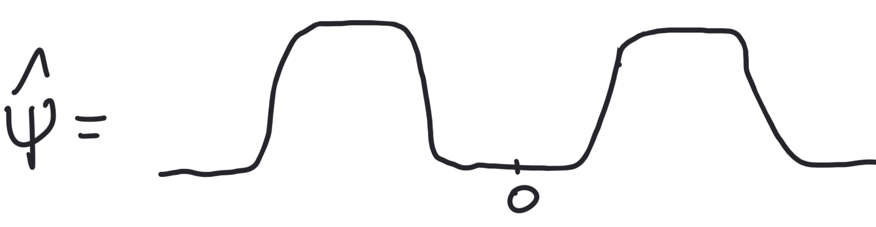
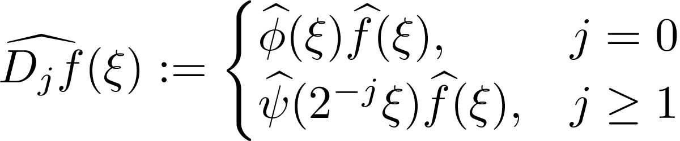
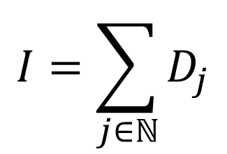
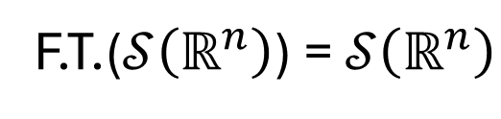
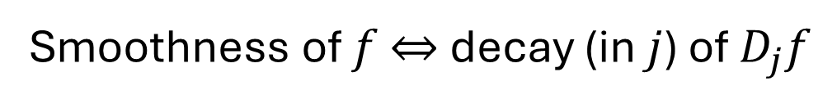
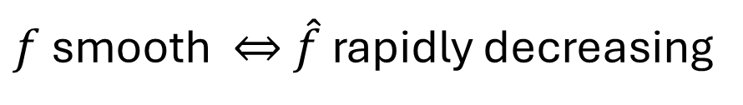
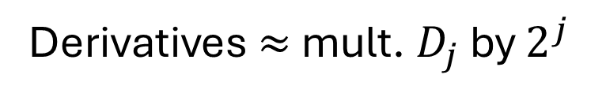

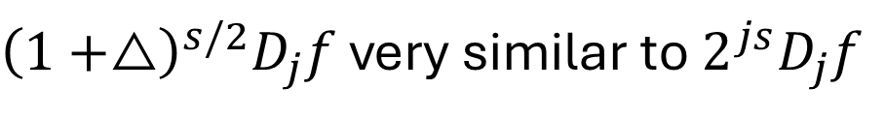

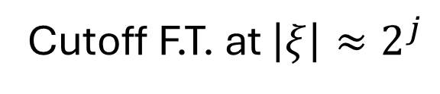
Littlewood-Paley-Stein Theory
$f$ smooth ⇔ $\hat{f}$ rapidly decreasing
F.T.($𝒮\left(ℝ^{n}\right)$) = $𝒮\left(ℝ^{n}\right)$
Let’s quantify this!
$$\hat{φ}∈C_{0}^{∞}\left(ℝ^{n}\right)$$
$$\hat{ψ}\left(ξ\right)=\hat{φ}\left(ξ\right)−\hat{φ}\left(2ξ\right)$$
$$I=\sum_{j∈ℕ}{D_{j}}$$
Cutoff F.T. at $\left|ξ\right|≈2^{j}$
${\left(1+△\right)}^{s/2}D_{j}f$ very similar to $2^{js}D_{j}f$
Derivatives $≈$ mult. $D_{j}$ by $2^{j}$
Smoothness of $f$ ⇔ decay (in $j$) of $D_{j}f$

Slide 8
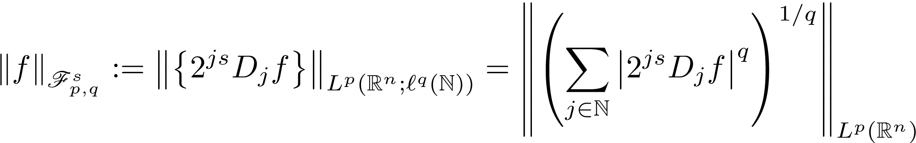
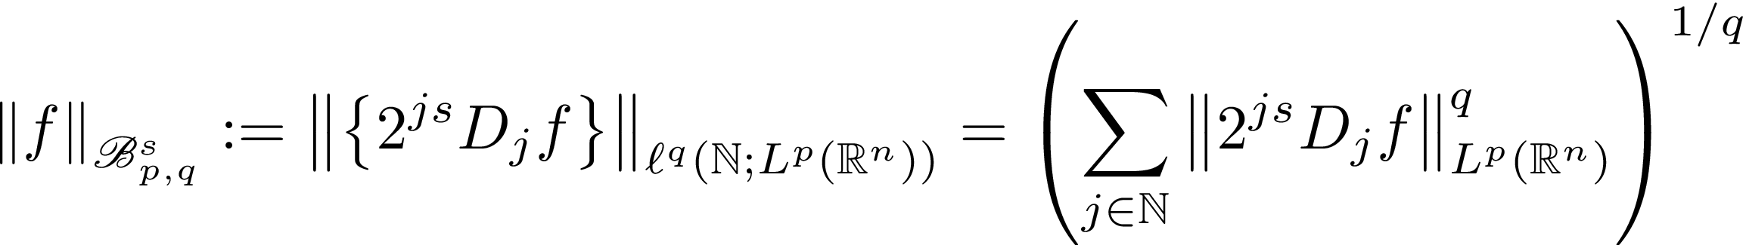
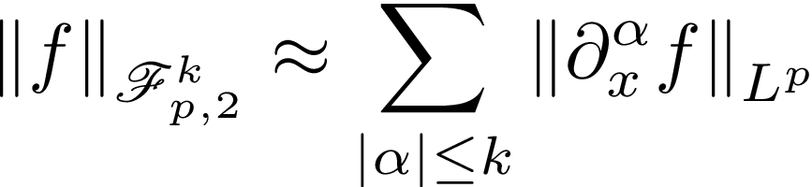

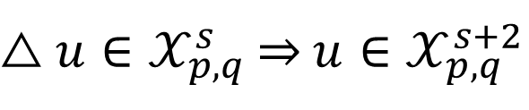


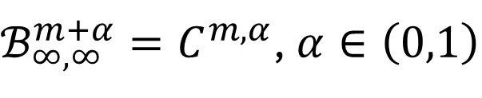
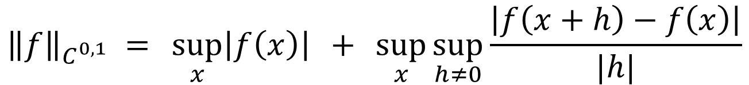
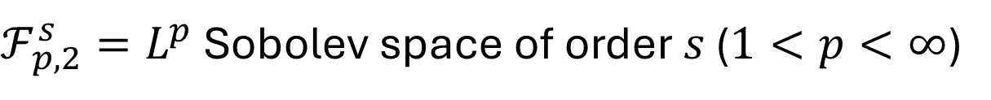
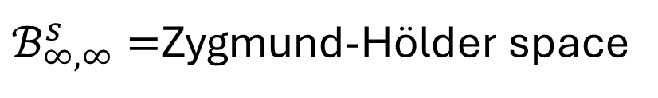
Triebel-Lizorkin and Besov Spaces
$$p,q∈\left(0,∞\right],s∈ℝ$$
$ℱ_{p,2}^{s}=L^{p}$ Sobolev space of order $s$ ($1<p<∞$)
$ℬ_{∞,∞}^{m+α}=C^{m,α}$, $α∈\left(0,1\right)$
$$C^{1}⊊C^{0,1}⊊ℬ_{∞,∞}^{1}$$
$ℬ_{∞,∞}^{s}=$Zygmund-Hölder space
$△u∈𝒳_{p,q}^{s}$ ⇒ $u∈𝒳_{p,q}^{s+2}$
$${\left\|f\right\|}_{C^{0,1}} = \sup_{x}\left|f\left(x\right)\right| + \sup_{x}{\sup_{h≠0}{\frac{\left|f\left(x+h\right)−f\left(x\right)\right|}{|h|}}}$$
First order difference

Slide 9

Triebel-Lizorkin and Besov Spaces
$$p,q∈\left(0,∞\right],s∈ℝ$$
Why??
Even if you only cared about Sobolev and
Hölder spaces, this is a good approach
Beyond Sobolev and Hölder, important
for nonlinear PDEs, trace theorems, …
$ℱ_{p,2}^{s}=L^{p}$ Sobolev space of order $s$ ($1<p<∞$)
$ℬ_{∞,∞}^{m+α}=C^{m,α}$, $α∈\left(0,1\right)$
$$C^{1}⊊C^{0,1}⊊ℬ_{∞,∞}^{1}$$
$ℬ_{∞,∞}^{s}=$Zygmund-Hölder space
$△u∈𝒳_{p,q}^{s}$ ⇒ $u∈𝒳_{p,q}^{s+2}$
$${\left\|f\right\|}_{ℬ_{∞,∞}^{1}} = \sup_{x}\left|f\left(x\right)\right| + \sup_{x}{\sup_{h≠0}{\frac{\left|f\left(x+2h\right)−2f\left(x+h\right)+f(x)\right|}{|h|}}}$$
Tip: If $C^{m,α}$ works except for $α∈\{0,1\}$, try $ℬ_{∞,∞}^{s}$
Second order difference

Slide 10
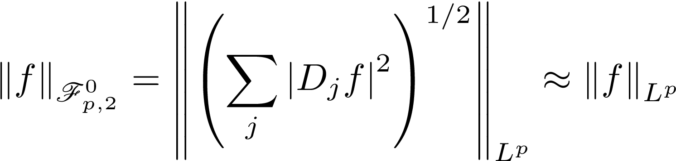
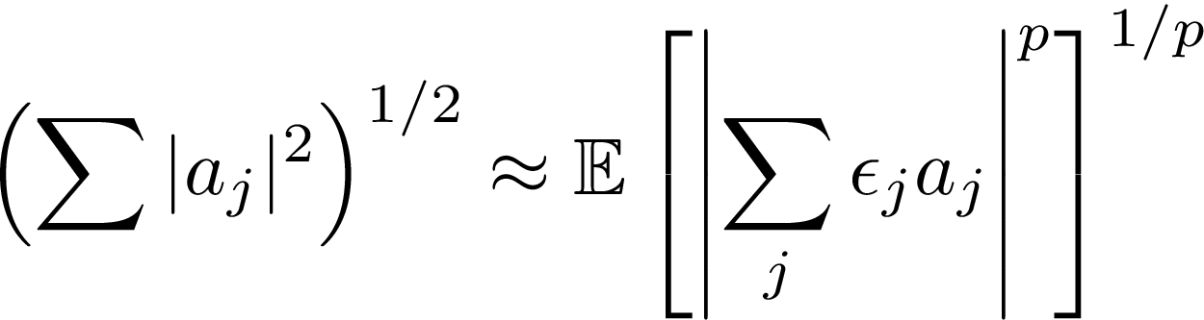
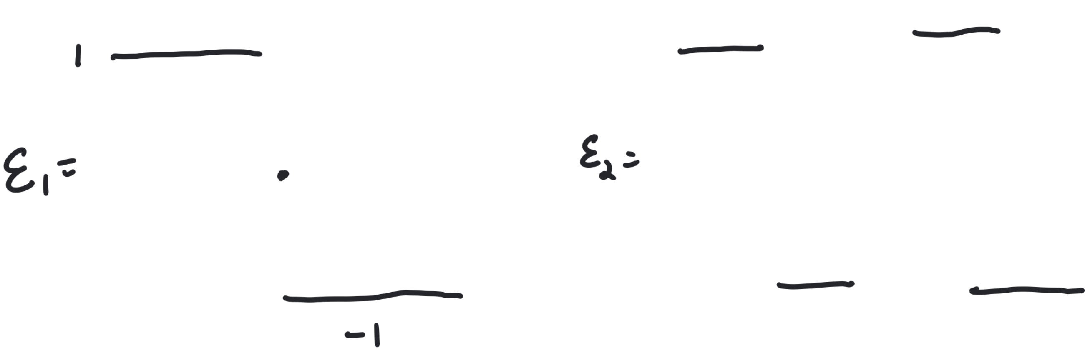
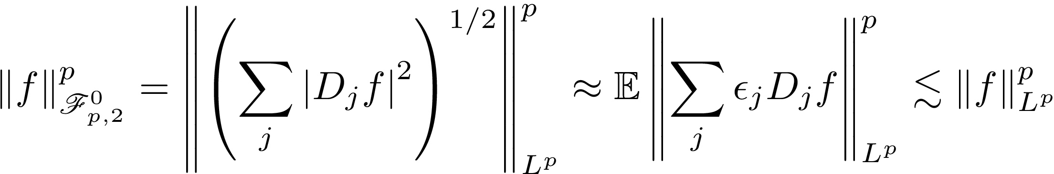


Littlewood-Paley-Stein Theory ⇔ Singular Integrals
$$1<p<∞$$
Let prove this!
Littlewood-Paley Square Function
Khintchine inequality: $ε_{1},ε_{2},…∈\{−1,1\}$ i.i.d., random variables of mean zero
SIO uniformly in $ε$
Conversely, to prove SIOs bounded on $L^{p}$, use $L^{p}=ℱ_{p,2}^{0}$
Good theory of SIOs ⇔ Good theory of function spaces
When studying PDEs we can exploit this!

Slide 11
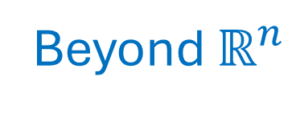
Beyond $ℝ^{n}$
What can we do when the Fourier Transform doesn’t help?
Lots of answers to this!
Two common settings:
Homogeneous Nilpotent Lie Groups –group structure, dilations, smoothness
Spaces of homogeneous type—none of that!
Two extremes: eventually will land somewhere in the middle

Slide 12





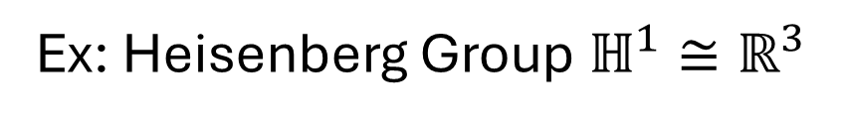

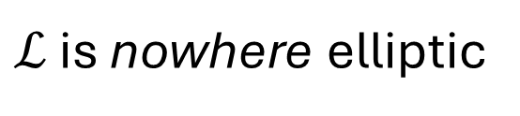







Nilpotent Lie Groups
Ex: Heisenberg Group $ℍ^{1}≅ℝ^{3}$
$$\left(x_{1},y_{1},t_{1}\right)⋅\left(x_{2},y_{2},t_{2}\right)=\left(x_{1}+x_{2},y_{1}+y_{2},t_{1}+t_{2}+2\left(x_{2}y_{1}−y_{2}x_{1}\right)\right)$$
$$δ\left(x,y,t\right)=\left(δx,δy,δ^{2}t\right)$$
$$δ\left(ξ⋅η\right)=\left(δξ\right)\left(δη\right)$$
$$\left\|\left(x,y,t\right)\right\|=\left|x\right|+\left|y\right|+{\left|t\right|}^{1/2}$$
$$\left\|δξ\right\|=δ\left\|ξ\right\|$$
$$X=∂_{x}+2y∂_{t}$$
$$Y=∂_{y}−2x∂_{t}$$
$$T=−4∂_{t}$$
$$\left[X,Y\right]=T$$
Hörmander’s condition: $X,Y,\left[X,Y\right]$ span tangent space at every point
$$τ_{η}f\left(ξ\right)=f\left(η⋅ξ\right)$$
$$D_{δ}f\left(ξ\right)=f\left(δξ\right)$$
$$τ_{η^{−1}}Xτ_{η}=X$$
$$D_{δ^{−1}}XD_{δ}=δX$$
Same for $Y$
$$ℒ=X^{2}+Y^{2}$$
Hörmander’s subLaplacian
Hörmander: $ℒ$ is hypoelliptic (in fact, subelliptic)
$ℒ$ is nowhere elliptic

Slide 13

Singular Integrals on $ℍ^{1}$
$$Tf\left(ξ\right)=\int{T\left(ξ,η\right)f\left(η\right)dη}$$
$$T:C_{0}^{∞}\left(ℍ^{1}\right)→C^{∞}\left(ℍ^{1}\right)$$
Distributional kernel
$T$ is pseudolocal:
$U∩V=∅$
$$f↦Tf{\left.​\right|}_{V}:ℰ^{′}\left(U\right)→C^{∞}\left(V\right)$$
Equiv: $T\left(ξ,η\right)∈C^{∞}\left(\{ξ≠η\}\right)$
$D_{δ^{−1}}τ_{η^{−1}}Tτ_{η}D_{δ}$ satisfy the above uniformly in $η,δ$
And the same for $T^{∗}$
$$R=1,η =0$$
$$ξ=0,\left\|η^{−1}ξ\right\|=1$$
Defn: $T:C_{0}^{∞}\left(ℍ^{1}\right)→C^{∞}\left(ℍ^{1}\right)$ is a singular integral if
$$W=\left(X,Y\right)$$
(Growth): $\left|W_{ξ}^{α}W_{η}^{β}T\left(ξ,η\right)\right|≤C_{α,β}{\left\|η^{−1}ξ\right\|}^{−4−\left|α\right|−\left|β\right|}$
not integrable (singular integral)
(Cancellation): $∀φ∈C_{0}^{∞}\left(B^{3}\left(1\right)\right)$,
And the same for $T^{∗}$
SIOs form an algebra, bounded on lots of spaces like $L^{p},1<p<∞$

Slide 14

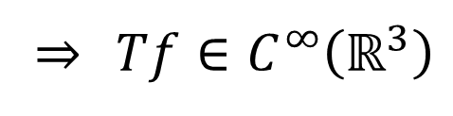


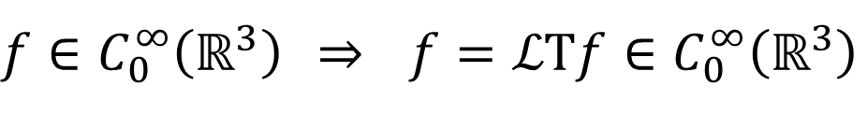
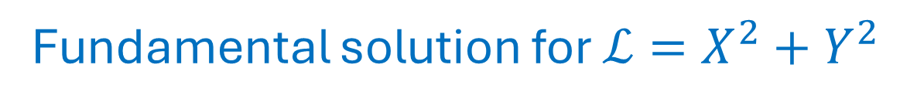





Fundamental solution for $ℒ=X^{2}+Y^{2}$
$$D_{δ^{−1}}ℒD_{δ}=δ^{2}ℒ$$
$$τ_{η^{−1}}ℒτ_{η}=ℒ$$
$$Tℒ=I=ℒT$$
$$D_{δ^{−1}}TD_{δ}=δ^{−2}T$$
$$τ_{η^{−1}}Tτ_{η}=T$$
$$D_{δ^{−1}}XYTD_{δ}=XYT$$
$ℒu∈C^{∞}$ near $ξ$ ⇒ $u∈C^{∞}$ near $ξ$ (hypoellipticity)
$U∩V=∅$, $f∈ℰ^{′}\left(U\right)$ ⇒ $ℒTf{\left.​\right|}_{V}=f{\left.​\right|}_{V}=0∈C^{∞}\left(V\right)$
⇒ $Tf{\left.​\right|}_{V}∈C^{∞}\left(V\right)$
$f∈C_{0}^{∞}\left(ℝ^{3}\right)$ ⇒ $f=ℒTf∈C_{0}^{∞}\left(ℝ^{3}\right)$
⇒ $Tf∈C^{∞}\left(ℝ^{3}\right)$
Combine with translation and dilation invariance:
$XYT,YXT,X^{2}T,Y^{2}T$ are SIOs
Conclude: $u$ is two derivatives better than $ℒu$ in lots of function spaces
$ℒu∈L_{\text{loc}}^{p}$ ⇒ $XYu,YXu,X^{2}u,Y^{2}u∈L_{\text{loc}}^{p},$ $1<p<∞$
Only used hypoellipticity and
(quantitative)
translation and dilation invariance

Slide 15








Function spaces on $ℍ^{1}$
$$\hat{φ}∈C_{0}^{∞}\left(ℝ^{3}\right)$$
group dilation
$$\hat{ψ}\left(ξ\right)=\hat{φ}\left(ξ\right)−\hat{φ}\left(2ξ\right)$$
$$I=\sum{D_{j}}$$
Function space adapted to group!
Generalizes classical spaces
(exactly how you want it to)

Slide 16








Spaces of homogeneous type (Coifman—Weiss)
$\left(M,ρ\right)$=metric space
$μ$=Borel measure
Main assumption: $μ\left(B\left(x,2δ\right)\right)≲μ\left(B\left(x,δ\right)\right)$
On $ℝ^{n}$, $\left|B^{n}\left(x,2δ\right)\right|=2^{n}\left|B\left(x,δ\right)\right|$
Singular Integral Operator: $Tf\left(y\right)=\int{T\left(x,y\right)f\left(y\right)dμ\left(y\right)}$
$$|T(x,y)|≲μ(B{\left(x,ρ\left(x,y\right)\right)}^{−1}$$
not integrable!
Translation and
dilation invariance!
Also need cancellation
$${\left|x−y\right|}^{−n}$$
Bounded on $L^{p}$, $1<p<∞$
Get function spaces but only for $\left|s\right|<1$
No such thing as infinite smoothness on metric spaces; problem for PDEs

Slide 17
Split the difference
Next time: A theory with no group, no dilations
But still have infinite smoothness
Apply this to PDEs
Thank you!

